Slide 1

Exploring God’s Word
Home Bible Study
“And they spake unto him the word of the Lord, and to all that
“…they received the word with
all readiness of mind, and searched
were in his house.”
Acts 16:32
the scriptures daily…”
Acts 17:11

Slide 2
Exploring God’s Word
Home Bible Study
Lesson
One

Slide 3
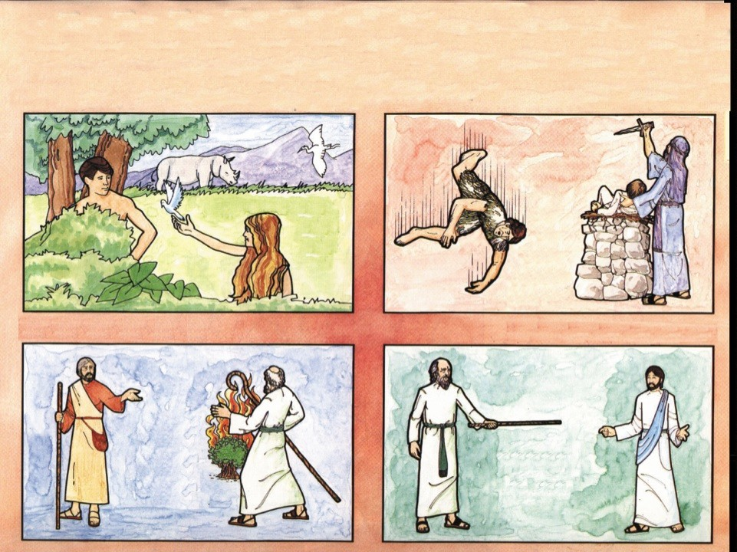
Introduction to the Old Testament
Time Periods
Innocence
Conscience
Adam
and Eve
The Fall of Man to Abraham
The Patriarchs
Law and Prophets
Abraham
to Moses
Moses
to Christ

Slide 4
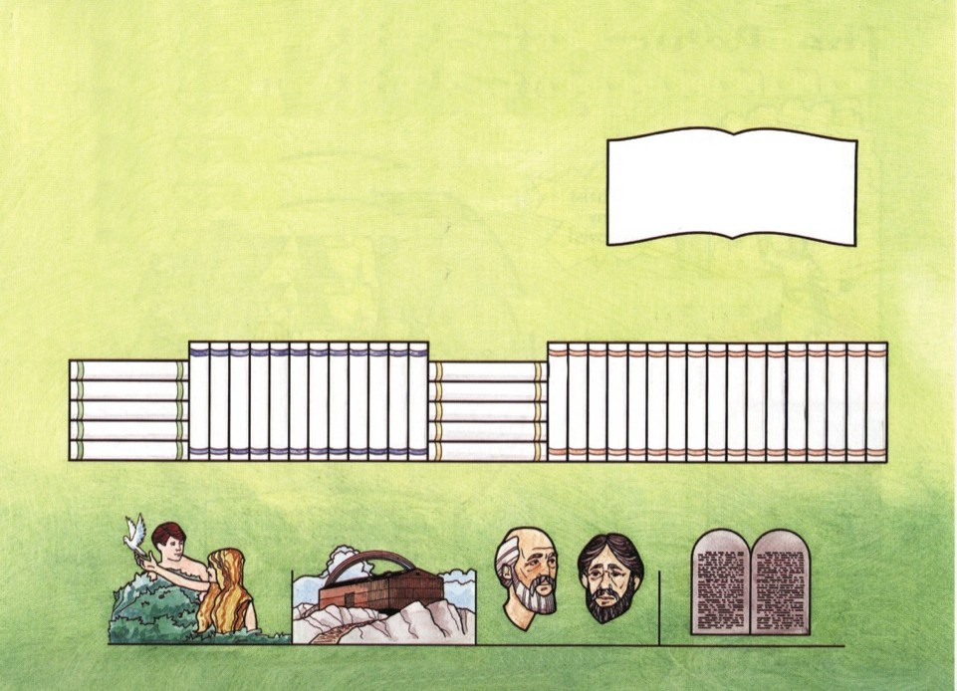
Books of the Old Testament
1 Author
32 Writers
Over 3,600 Years of Man’s History 1,500 Years in Writing
History
“For the prophecy came not in old time by the will of man: but holy men of God spake as they were moved by the Holy
Ghost.”
II Pet 1:21
Prophecy 17
Law 5
Genesis
Exodus
Leviticus Numbers Deuteronomy
12
Poetry 5
Job
Psalms Proverbs Ecclesiastes Songs of Solomon
Esther
Nehemiah Ezra
II Chronicles I Chronicles II Kings
Kings
Samuel I Samuel Ruth Judges Joshua
Malachi
Zechariah Haggai
Zephaniah
Habakkuk Nahum
Micah Jonah Obadiah Amos
Joel Hosea Daniel Ezekiel
Lamentations
Jeremiah Isaiah
Innocence
Conscience Patriarchs
Time Periods
Law

Slide 5
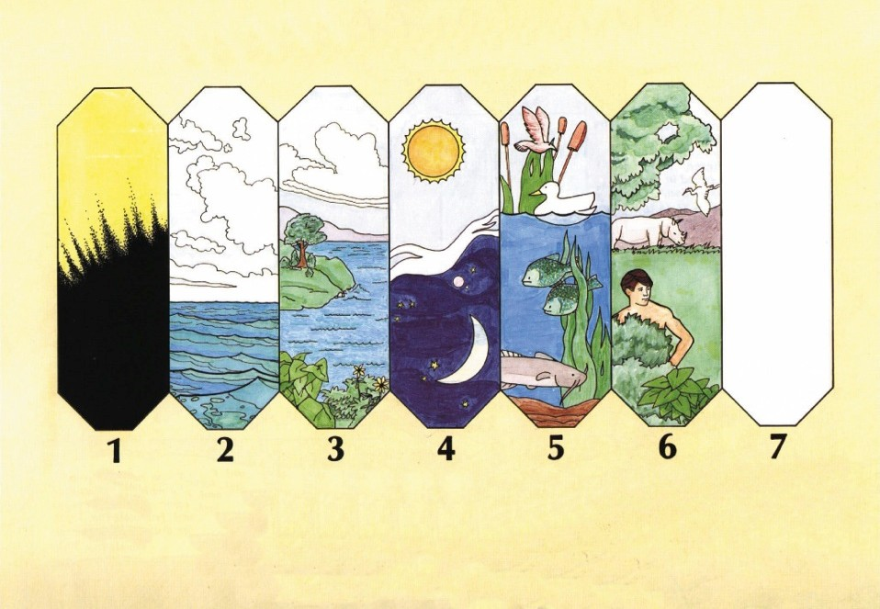
In the Beginning God
“And on the seventh day God ended his work which he had made; and he rested on the seventh day…”
Genesis 2:2
Light and
Darkness Divided
The Firmament (sky)
Division
of Water
Dry Land—Seas
Grass Herbs Trees
Sun—Moon Stars
Days Seasons Years
Fish
of the Sea
Birds of the Air
Animals and Man
God Rested on this Day
CREATION WEEK

Slide 6
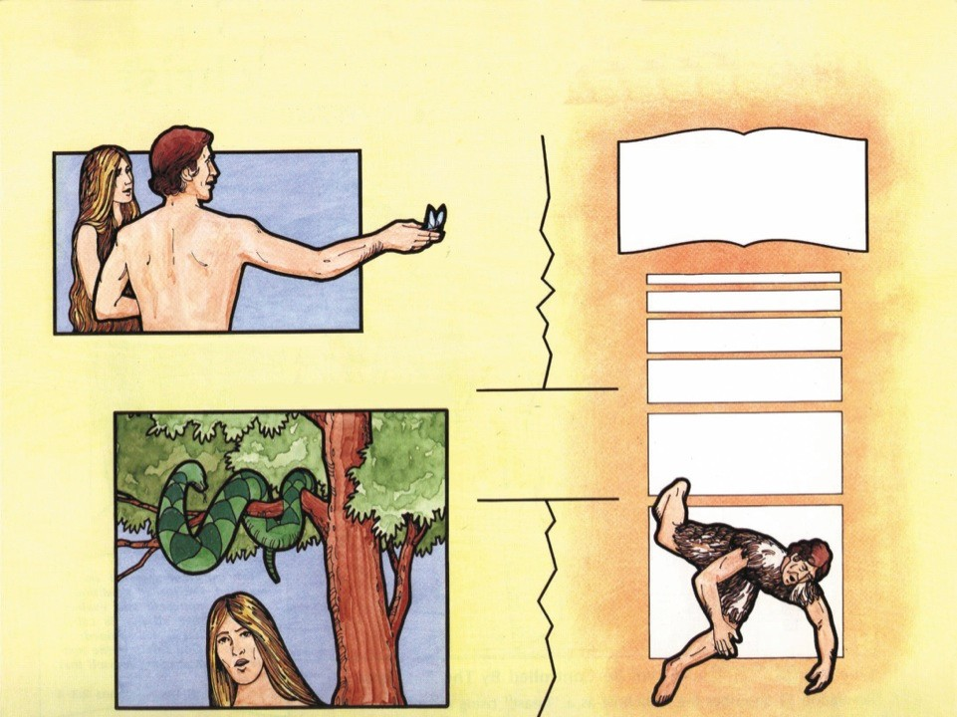
Power of Choice
Adam and Eve
“But of the tree of the knowledge of good and evil, thou shalt not eat of it: for in the day that thou eatest thereof thou shalt
surely die.”
Genesis 2:17
The Time of Innocence Genesis 2:25
Man Chose Sin
Genesis 3:1-8
Sin Breaks Communion with God
The Fall

Slide 7
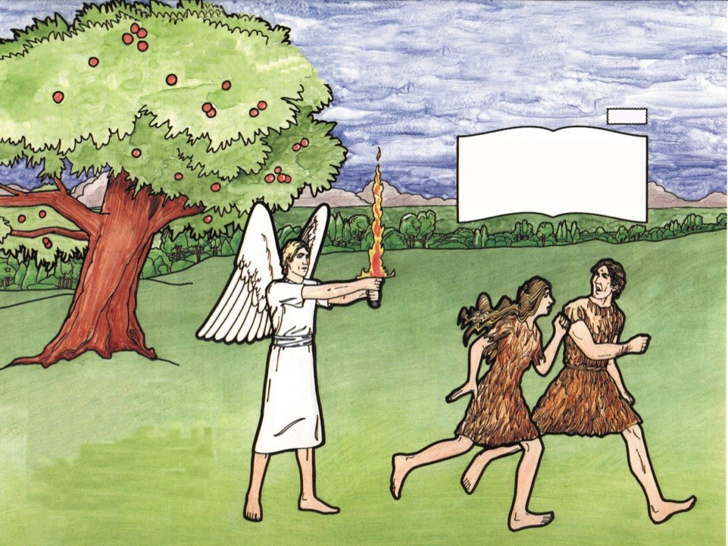
The First Judgment
Promise
“And I will put enmity between thee and the woman, and between thy seed and her seed; it shall bruise thy head, and thou shalt
bruise his heel.”
Genesis 3:15
Four Curses
Genesis 3:15-19
Curse on the Devil
Curse on the Woman
Curse on the Land
Curse on the Man

Slide 8
Exploring God’s Word
Home Bible Study
Lesson
Two

Slide 9
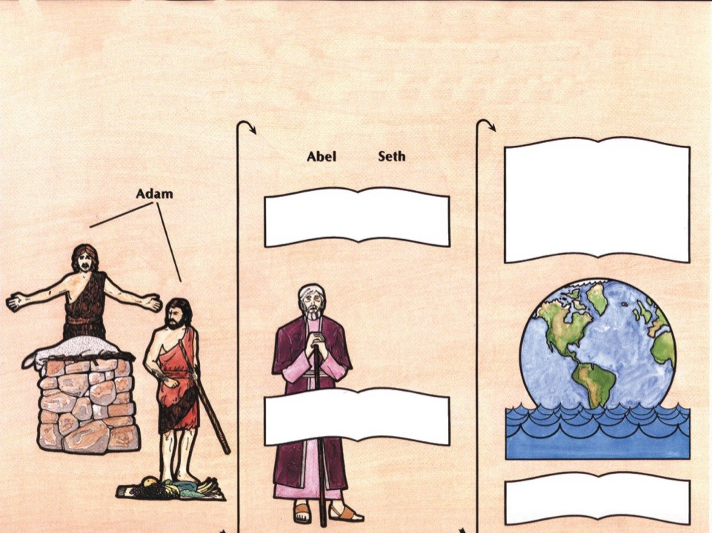
From the Fall to the Flood
The Time of Conscience
“And God saw that the wickedness of man was great in the earth, and that every imagination of the thoughts of his heart was only evil continually.
And it repented the LORD that he had made man on the earth, and it grieved him at his heart.”
Genesis 6:5-6
“Then began men to call upon the name of the LORD.”
Genesis 4:26
Abel
Cain
“And Enoch walked with God: and he was not; for God
took him.”
Genesis 5:24
Proper Sacrifice
“But Noah found grace in the eyes of the LORD.”
Genesis 6:8
Improper Sacrifice
Genesis 4:3-7

Slide 10
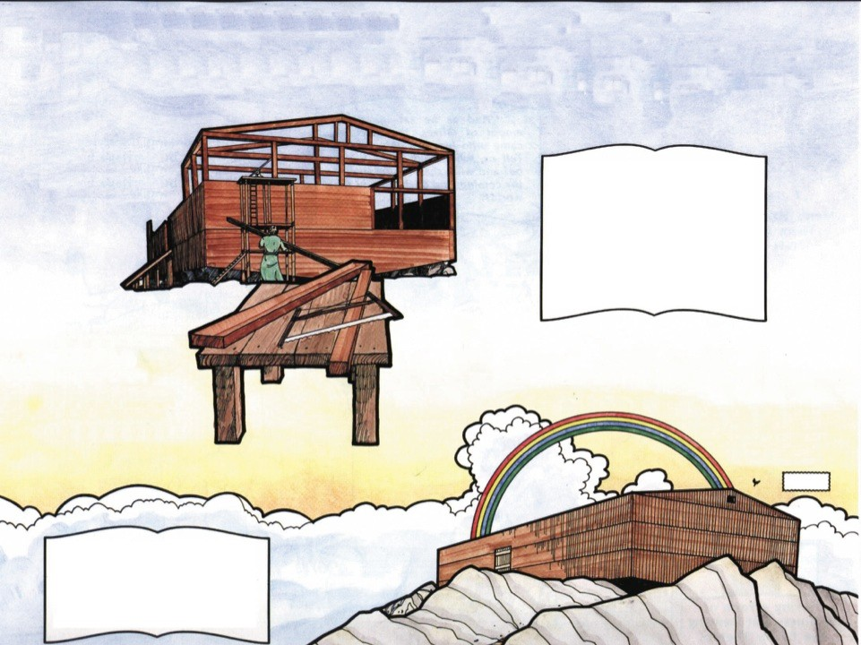
The Righteous Family Preserved
Building of the Ark
Genesis 6:14-16
“And the LORD said, My spirit shall not always strive with man…
And the LORD said, I will destroy man whom I have created
from the face of the earth; both man, and beast, and the creeping thing, and the fowls of the air; for it repenteth me that I have made
Ark Features 1 Door
3 Floors
450 Ft. Long
45 Ft. High
75 Ft. Wide
them.”
Genesis 6:3, 7
Covenant of the Rainbow
Genesis 9:11-13
Promise
“And spared not the old world, but saved Noah the eighth person, a preacher of righteousness, bringing in the flood upon the
world of the ungodly.”
II Peter 2:5

Slide 11
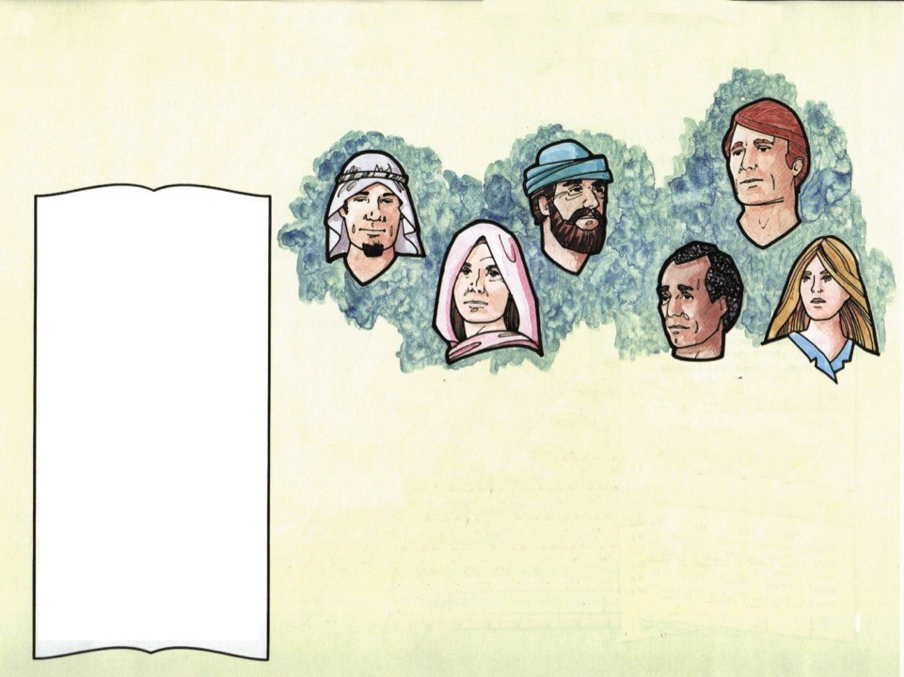
Mankind Judged
“But as the days of Noe were, so shall also the coming of the Son of man be.
For as in the days that were before the flood they were eating and drinking, marrying and giving in marriage, until the day that Noe entered into the ark,
And knew not until the flood came, and took them all away; so shall also the coming of the Son of man be.
Then shall two be in the field; the one shall be taken, and the other left.
Two women shall be grinding at the mill; the one shall be taken, and the other left.
Watch therefore: for ye know not what hour your Lord doth come.
But know this, that if the goodman of the house had known in what watch the thief would come, he would have watched, and would not have suffered his house to be broken up.
Therefore be ye also ready: for in such an hour as ye think not the Son of man cometh.” Matthew 24:37-44
Days of Noah
Genesis 6:5, 11
Son of Man
Partying Marrying and Giving in Marriage They Bought, Sold, Planted, Built Ignorant of Coming Judgment Extreme Wickedness
The Flood Comes
Philippians 3:17-19
Matthew 24:38-39
Luke 17:26-30
Luke 21:34-35
II Timothy 3:1-4
II Peter 3:3-7

Slide 12
Exploring God’s Word
Home Bible Study
Lesson
Three

Slide 13
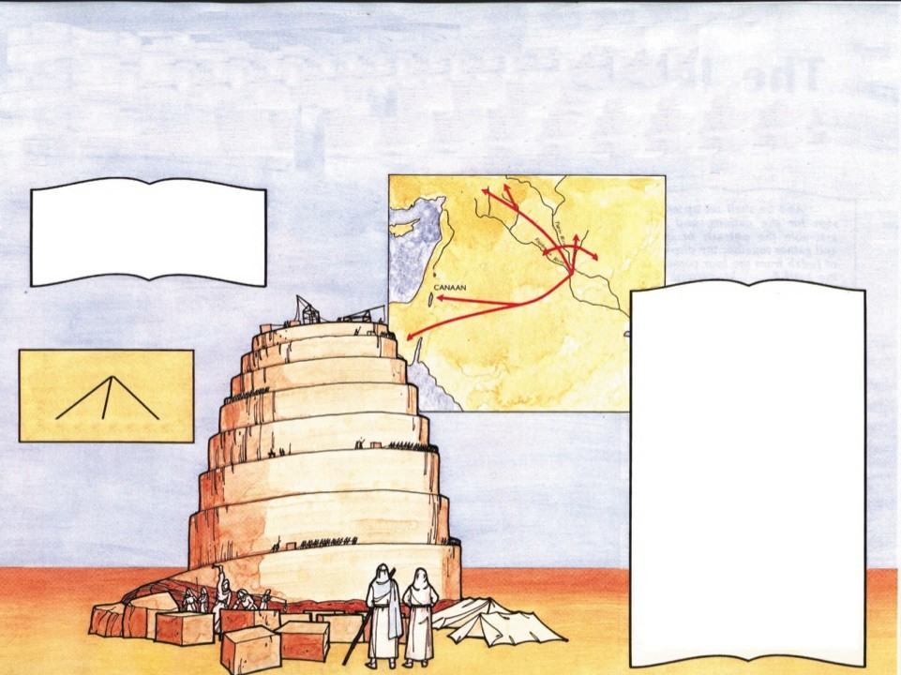

The Origin of Languages/
The Beginning of Nations
“Now these are the generations of the sons of Noah, Shem, Ham, and Japheth: and unto them were sons born after
The Great Sea
the flood.”
MESOPOTAMIA
Shem
Genesis 10:1
“And the LORD came down to see the city and the tower, which the children of men builded.
And the LORD said, Behold, the people is one, and they have all one language; and this they begin to do: and now nothing will be restrained from them, which they have imagined to do.
Go to, let us go down, and there confound their language, that they may not understand one another's speech.
So the LORD scattered them abroad from thence upon the face of all the earth: and they left off to build the city.
Therefore is the name of it called Babel; because the LORD did there confound the language of all the earth: and from thence did the LORD scatter them abroad upon the face of all the earth.”
Genesis 11:5-9
CHALDEA
Noah
Shem Ham Japheth

Slide 14
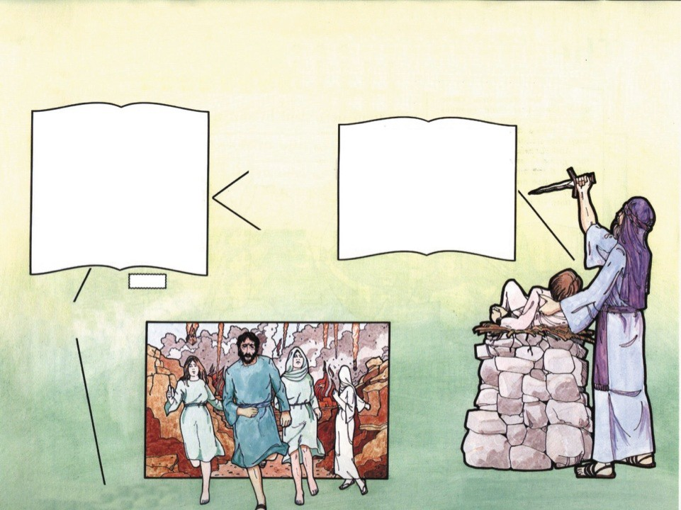
The Chosen Nation
The Time of the Patriarchs
God Calls Abraham
Birth of Isaac
“Now the LORD had said unto Abram, Get thee out of thy country, and from thy kindred, and from thy father's house, unto a land that I will show thee:
And I will make of thee a great nation, and I will bless thee, and make thy name great; and thou shalt be a blessing:
And I will bless them that bless thee, and curse him that curseth thee: and in thee shall all families of the earth be blessed.”
Genesis 12:1-3
“And the LORD visited Sarah as he had said, and the LORD did unto Sarah as he had spoken.
For Sarah conceived, and bare Abraham a son in his old age, at the set time of which God had spoken to him.
And Abraham called the name of his son that was born unto him, whom Sarah bare to him, Isaac.”
Genesis 21:1-3
Covenant of Circumcision— Genesis 17:10-14
Birth of Ishmael Genesis 16:15 Arab Nations
Promise
Lot and Abraham Separate
Genesis 13:8-13
Lot’s Family Flees Sodom
Genesis 19:1-28
Abraham Offers Isaac as Sacrifice
Genesis 22:1-14

Slide 15
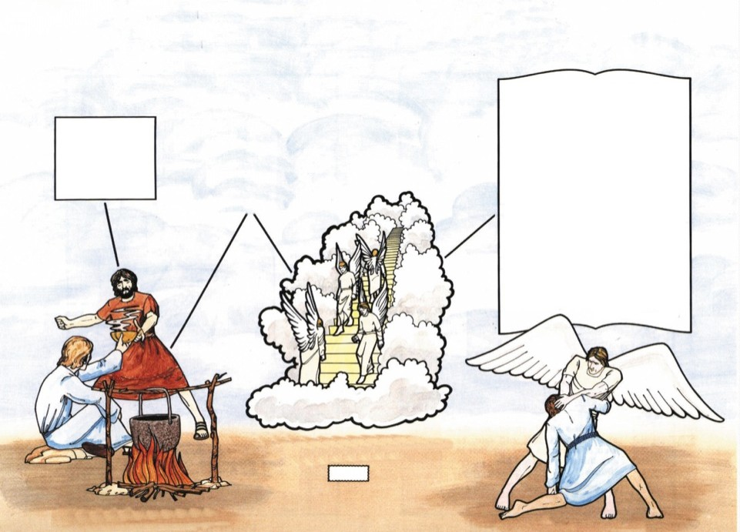
The Chosen Nation
“And Jacob was left alone; and there wrestled a man with him until the breaking of the day.
And when he saw that he prevailed not against him, he touched the hollow of his thigh; and
Genesis 25:21-26
Isaac
Jacob Steals Blessing Genesis 27:26-33
the hollow of Jacob's thigh was out of joint, as he wrestled with him.
And he said, Let me go, for the day breaketh. And he said, I will not let thee go, except thou bless me.
And he said unto him, What is thy name? And he said, Jacob.
And he said, Thy name shall be called no more Jacob, but Israel: for as a prince hast thou power with God and with men, and hast prevailed.”
Genesis 32:24-28
Esau
Jacob
Jacob’s Vision of Heaven
Genesis 28:10-22
Promise
Jacob Buys Birthright
Genesis 25:29-34
Jacob Renamed Israel

Slide 16
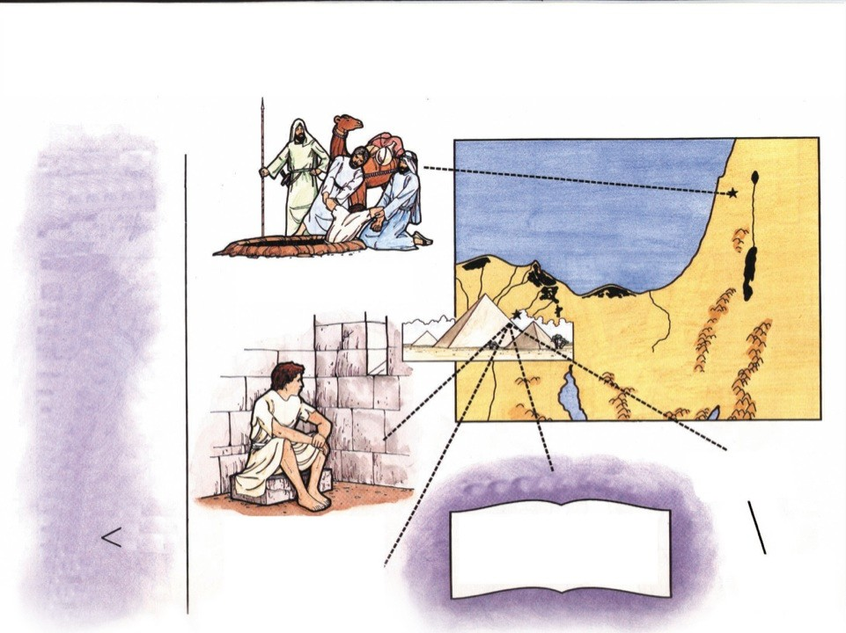
The Chosen Nation
Sons of Jacob
(Twelve Tribes of
Israel)
Reuben Simeon Levi Judah Zebulun Issachar Dan Gad Asher Naphtali
Ephraim
Joseph Sold by Brethren
Genesis 37:12-28
Egypt
Israelites Settle in Goshen Genesis 47:11-12
Joseph Forgives His Brethren
Joseph Benjamin
Genesis 48:5-6
Genesis 49:3-27
“Now therefore be not grieved, nor angry with yourselves, that ye sold me hither: for God did send me before you to preserve life.”
Genesis 45:5
Manasseh
Joseph Cast into Prison
Genesis 39
Joseph Interprets Pharaoh’s Dream Genesis 41
Israel Goes into Bondage Exodus 1:8-14

Slide 17
Exploring God’s Word
Home Bible Study
Lesson
Four

Slide 18
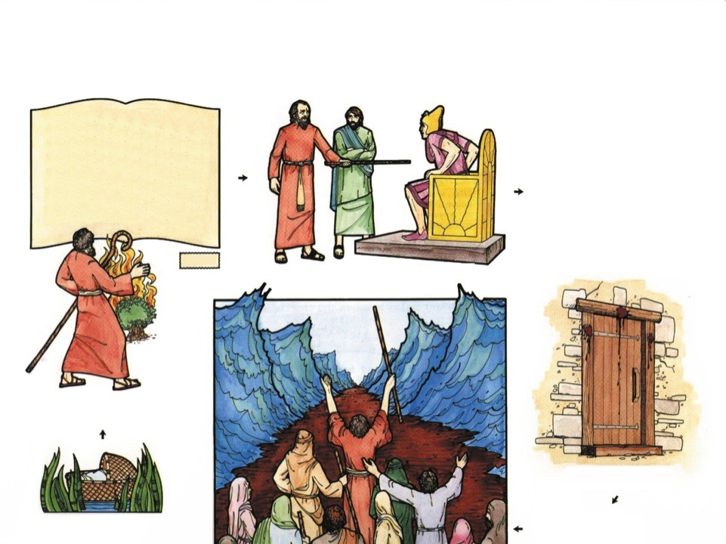
The Exodus
The Plan of Redemption
“And I am come down to deliver them out of the hand of the Egyptians, and to bring them up out of that land unto a good land and a large, unto a land flowing with milk and honey; unto the place of the Canaanites, and the Hittites, and the Amorites, and the Perizzites, and the Hivites, and the Jebusites.” Exodus 3:8
Ten Plagues
WATER TURNED TO BLOOD FROGS
LICE FLIES
EGYPTIAN CATTLE SLAIN BOILS
HAIL
LOCUSTS DARKNESS
EGYPTIAN FIRSTBORN SLAIN
Promise
Moses the Deliverer before Pharaoh
Moses and the Burning Bush
Exodus 3:1-10
Blood on Doorposts
Exodus 12:1-36
Birth of Moses
Exodus 2:2-10
Crossing the Red Sea
Exodus 14:13-31

Slide 19
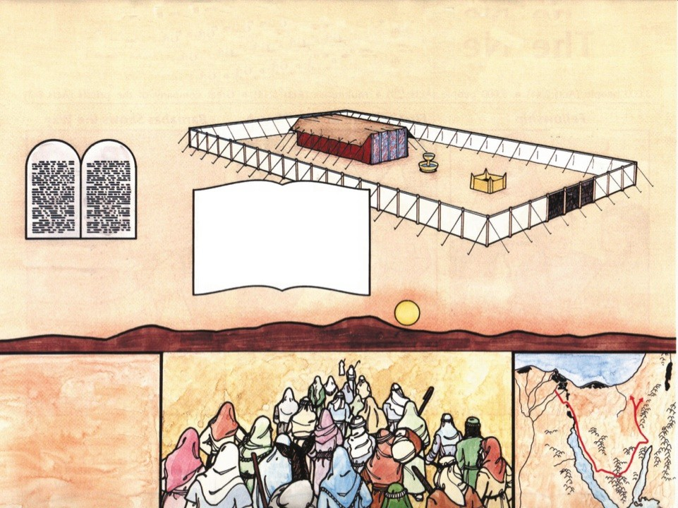
Israel at Sinai
The Time of the Law
Tabernacle
“And let them make me a sanctuary; that I may dwell among them.
According to all that I show thee, after the pattern of the
tabernacle, and the pattern of all the instruments thereof, even so
Giving of the
10 Commandments
Exodus 25:8
shall ye make it.”
Exodus 25:8-9
Wandering
in the Wilderness
40 Years

Slide 20
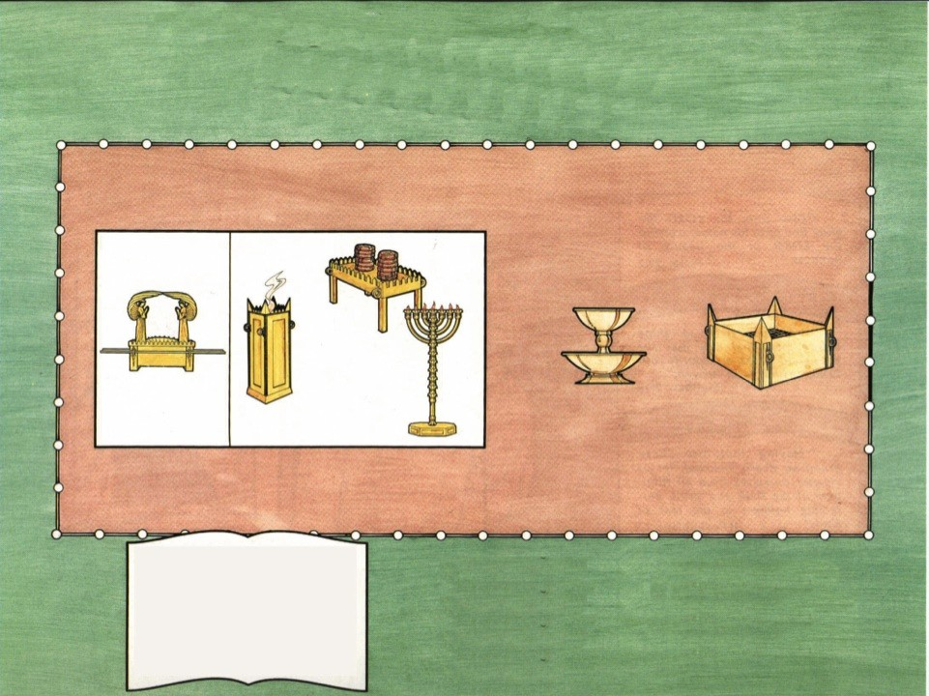
The Tabernacle
Man’s Approach to God
Not to Scale
“Who serve unto the example and shadow of heavenly things, as Moses was admonished of God when he was about to make the tabernacle: for, See, saith he, that thou make all things according to the pattern showed to thee in the
Types and Shadows
I Corinthians 10:11
Colossians 2:16-17
Hebrews 8:5
Hebrews 9:8-9, 24
Hebrews 10:1
I Peter 3:21
Dimensions of Tabernacle
10 Cubits High
10 Cubits Wide
30 Cubits Long
mount.”
Hebrews 8:5

Slide 21
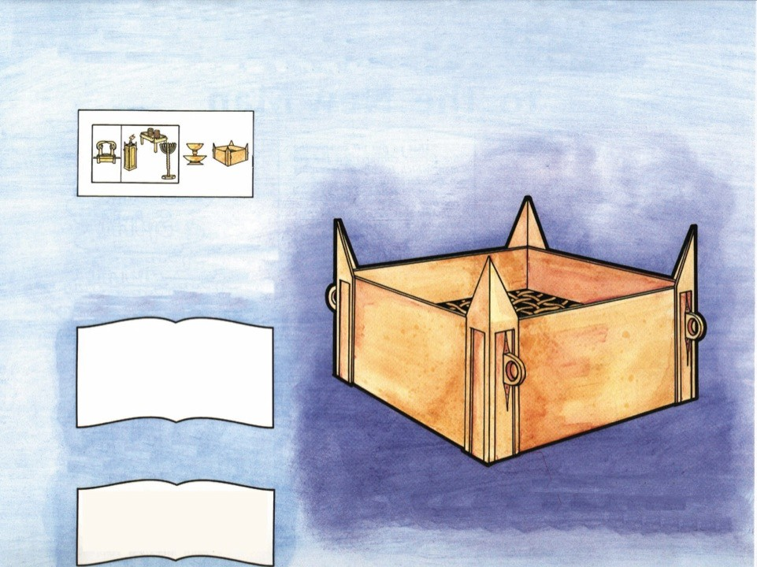
The Altar of Sacrifice
Not to Scale
The Priest approached the Tabernacle by way of the brazen altar, where he offered the sacrifice for sin.
“For the life of the flesh is in the blood: and I have given it to you upon the altar to make an atonement for your souls: for it is the blood that maketh an atonement for the soul.”
Leviticus 17:11
Jesus Christ became our perfect sacrifice.
Brazen Altar
The Place of Sacrifice
Death
Shed Blood
“The next day John seeth Jesus coming unto him, and saith, Behold the Lamb of God, which taketh away the sin of the world.”
John 1:29

Slide 22
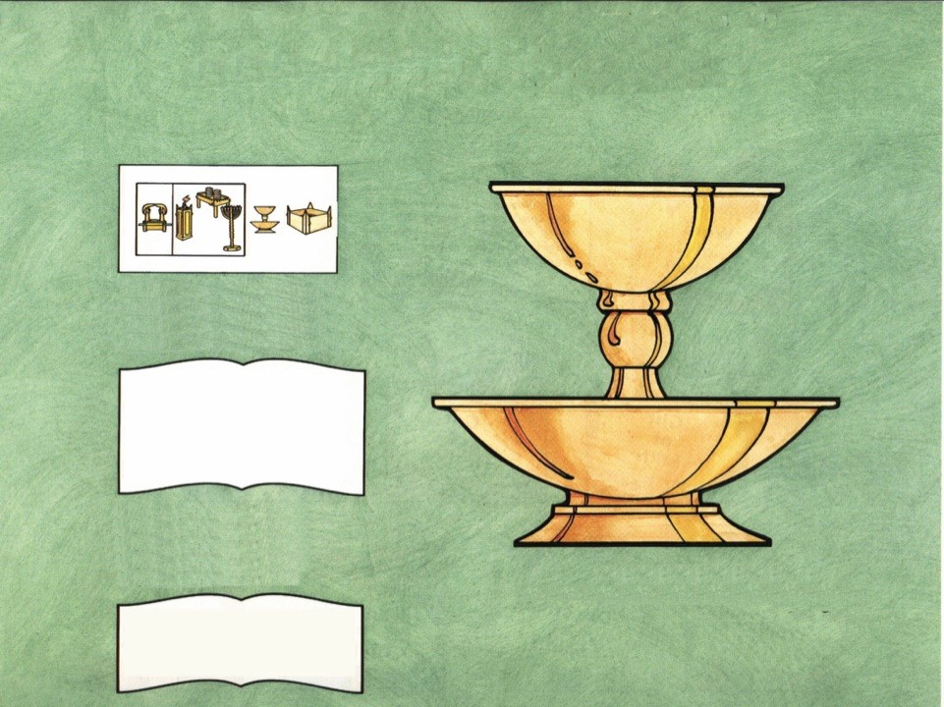
The Laver of Water
Not to Scale
The priest must wash at the laver before ministering at the altar or entering the Tabernacle.
“When they go into the tabernacle of the congregation, they shall wash with water, that they die not; or when they come near to the altar to minister, to burn offering made by fire unto
the LORD:”
Exodus 30:20
The laver was a place of washing and cleansing as baptism is a washing and cleansing from sin.
Brazen Laver
The Place of Cleansing
“And now why tarriest thou? arise, and be baptized, and wash away thy sins, calling on the
name of the Lord.”
Acts 22:16

Slide 23
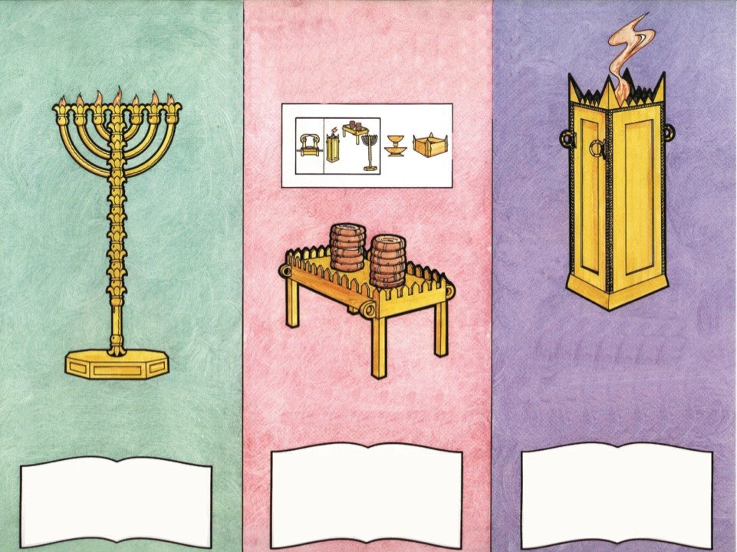
The Holy Place
(The Place of Worship)
Not to Scale
Revelation 8:3
Hebrews 13:15
Altar of Incense
The Fire Came from the Altar of Sacrifice
The Altar Was Placed Before the Veil
The Place of Daily Prayer and Praise
John 6:35
Golden Candlestick
The Only Light in the Tabernacle
Table of Shewbread
The Daily Bread of the Priest
“I am the living bread which came down from heaven: if any man eat of this bread, he shall live for ever: and the bread that I will give is my flesh, which I will give for the life of the world.” John 6:51
“But ye are a chosen generation, a royal priesthood, an holy nation, a peculiar people; that ye should show forth the praises of him who hath called you out of darkness into his
“Then spake Jesus again unto them, saying, I am the light of the world: he that followeth me shall not walk in darkness, but shall
have the light of life.”
John 8:12
marvellous light:”
I Peter 2:9

Slide 24
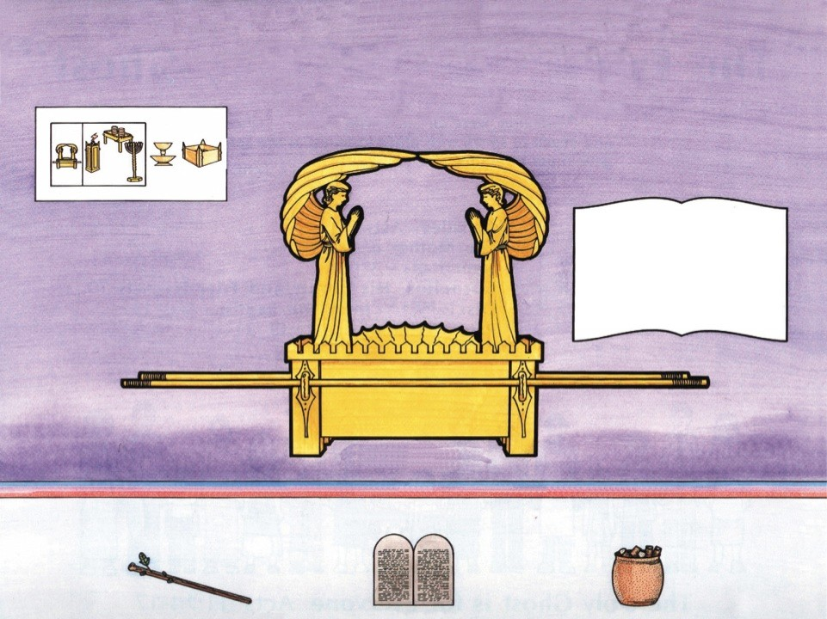
The Holy of Holies
(Beyond the Veil)
Not to Scale
“And there I will meet with thee, and I will commune with thee from above the mercy seat, from between the two cherubims which are upon the ark of the testimony, of all things which I will give thee in commandment unto the children of Israel.”
Exodus 25:22
Mercy Seat
Ark of the Covenant
Exodus 25:10-11
Veil of Blue, Purple, & Scarlet - Exodus 36:35 Veil—His Flesh - Hebrews 10:20
Contents of the Ark
Aaron’s Rod That Budded
Hebrews 9:4
Tables of Stone
Exodus 25:16 Hebrews 9:4
Pot of Manna
Hebrews 9:4

Slide 25
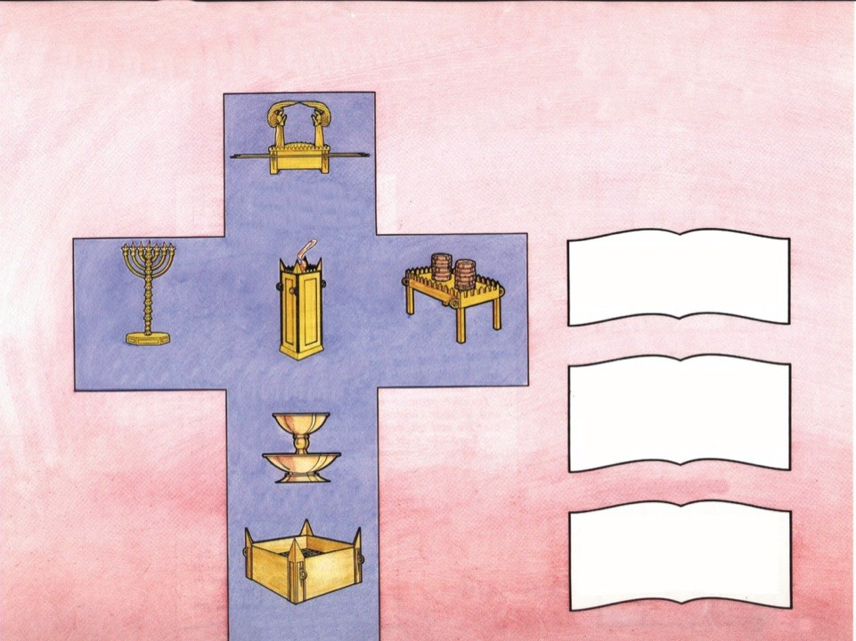
From the Tabernacle
to the Cross
Jesus
Way into Holiness
Hebrews 10:19-20
Holy Ghost
“And they were all filled with the Holy Ghost, and began to speak with other tongues, as the Spirit gave them utterance.”
Acts 2:4
Baptism
Jesus
Light of the World
John 12:35
Jesus Bread of Life John 6:33-35
Jesus Prayed in Garden
Luke 22:41-44
“Then Peter said unto them, Repent, and be baptized every one of you in the name of Jesus Christ for the remission of sins, and ye shall receive the gift of
the Holy Ghost.”
Acts 2:38
Repentance
Jesus – Baptized
Matthew 3:16
“Knowing this, that our old man is crucified with him, that the body of sin might be destroyed, that henceforth we should not
serve sin.”
Romans 6:6
Jesus
Our Offering for Sin
Hebrews 9:28

Slide 26
Exploring God’s Word
Home Bible Study
Lesson
Five

Slide 27
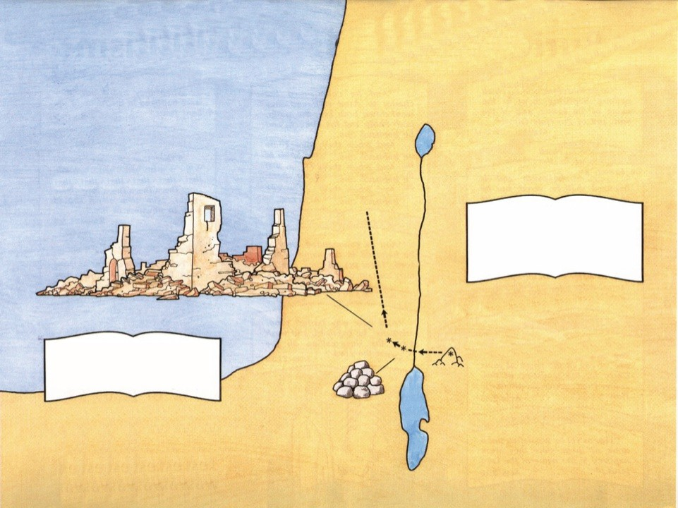
The Land of Promise
Land Subdued and
Divided Among
the Twelve Tribes
Sea of Galilee
Jericho Destroyed
Joshua 6
“There shall not any man be able to stand before thee all the days of thy life: as I was with Moses, so I will be with thee: I will not fail thee, nor forsake thee.”
Joshua 1:5
Joshua Leads Israel
Joshua 1:1-11
Jordan River
Jericho
“Nevertheless the LORD raised up judges, which delivered them out of the hand of those that spoiled them.” Judges 2:16
God Gives Judges to Rule
Gilgal
Moses Dies on Mt. Nebo
Twelve Stones
Joshua 4:20-24
Dead Sea
Othniel
Ehud
Shamgar
Deborah
Barak
Gideon
Abimelech
Tola
Jair
Jephthah
Ibson
Elon
Abdon
Samson
Eli
Samuel

Slide 28
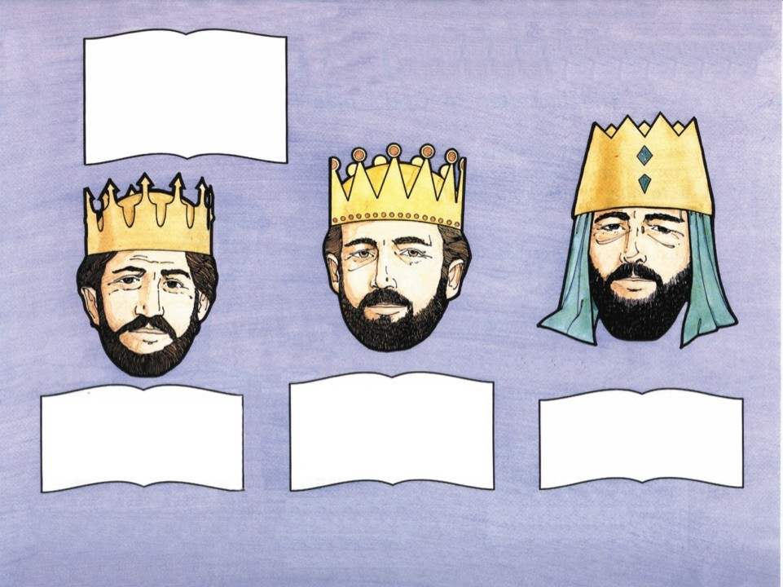
The United Kingdom
“Then all the elders of Israel gathered themselves together, and came to Samuel unto Ramah,
And said unto him, Behold, thou
art old, and thy sons walk not in thy ways: now make us a king to judge us like all the nations.”
I Samuel 8:4-5
Israel Demands
a King
Saul
40 Year Reign
David
40 Year Reign
Solomon
40 Year Reign
“Then Samuel took the horn of oil, and anointed him in the midst of his brethren: and the spirit of the LORD came upon David from that day forward. So Samuel rose up, and went to
“Then Samuel took a vial of oil, and poured it upon his head, and kissed him, and said, Is it not because the LORD hath anointed thee to be captain over
“And let Zadok the priest and Nathan the prophet anoint him there king over Israel: and blow ye with the trumpet, and say, God
his inheritance?”
Tribe of Benjamin
I Samuel 9:1
Head and Shoulders Above Other Men
I Samuel 9:2 Rejected By God I Samuel 16:14
Ramah.”
Shepherd Boy I Samuel 16:11 Slays Giant
I Samuel 17
Man After God’s Own Heart
Acts 13:22
save king Solomon.”
I Kings 1:34
I Samuel 10:1
I Samuel 16:13
God Gives Wisdom
I Kings 3
Builds Temple
I Kings 6

Slide 29
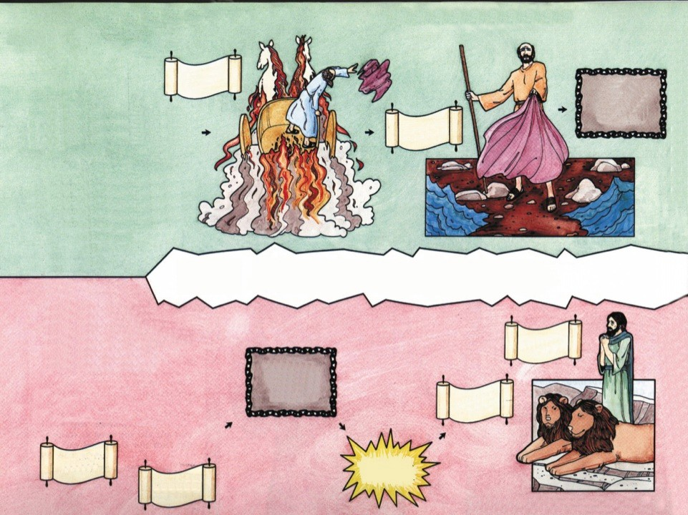
Assyrian Captivity 721 B.C.
Elijah
God sent prophets to warn Israel of impending judgment.
Elisha
Kingdom of Israel
Ten Tribes (Northern Kingdom)
Samaria – Capital 19 Kings
Jeroboam Revolts
The Divided Kingdom
Daniel
Babylonian Captivity
Rehoboam Solomon’s Son
Kingdom of Judah
Two Tribes (Southern Kingdom)
Jerusalem – Capital 19 Kings, 1 Queen
606 B.C.
Ezekiel
God sent prophets to warn Judah of impending judgment.
Isaiah
Jerusalem Destroyed
Jeremiah
Daniel and Ezekiel prophesied during the Babylonian Captivity

Slide 30
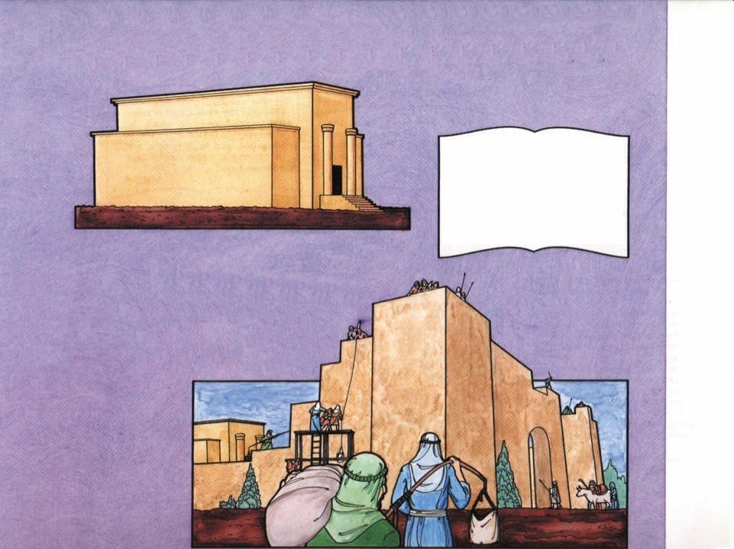
The Return to Jerusalem
“Behold, I will send my messenger, and he shall prepare the way before me: and the Lord, whom ye seek, shall suddenly come to his temple, even the messenger of the covenant, whom ye delight in: behold, he shall come, saith the LORD of hosts.” Malachi 3:1
Old Testament Ends
Four Hundred Years of Silence
Zerubbabel Rebuilds Temple (beginning 536 B.C.)
Prophets – Haggai, Zechariah, & Malachi encouraged and chastened the people.
Return from Babylon to Jerusalem
Zerubbabel Ezra Nehemiah
Nehemiah Rebuilds Walls
(444 B.C.)

Slide 31
Exploring God’s Word
Home Bible Study
Lesson
Six

Slide 32
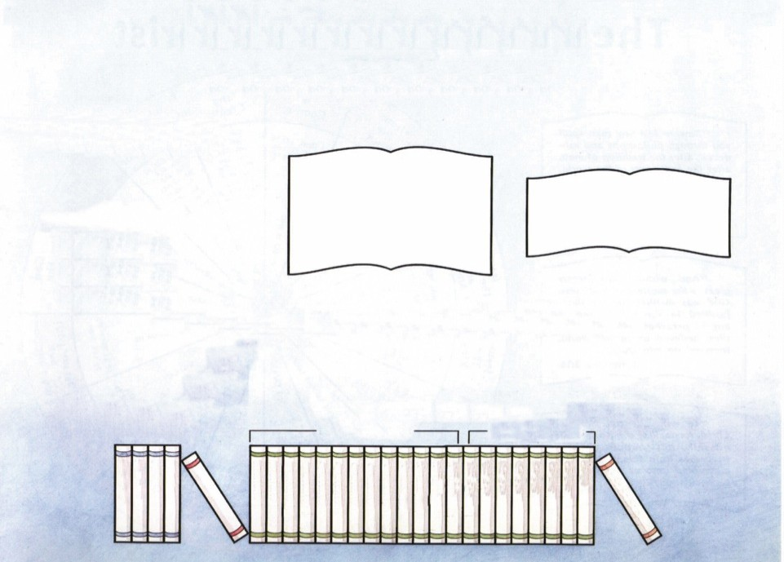

Introduction to the New Testament
400 Years of Silence between the Old Testament and the New Testament
“Think not that I am come to destroy the law, or the prophets: I am not come to destroy, but to fulfil.
For verily I say unto you, Till
heaven and earth pass, one jot or one tittle shall in no wise pass from the law, till all be fulfilled.”
Matthew 5:17-18
“All scripture is given by inspiration of God, and is profitable for doctrine, for reproof, for correction, for instruction in
27 Books
8 Authors
100 Years
righteousness:”
II Timothy 3:16
Books of the New Testament
History of the Church
Biographies of Christ
Instructions to the Church
Pauline Epistles General Epistles
Prophecy
John
Luke Mark
Matthew
Jude
III John II John I John II Peter I Peter James
Hebrews
Philemon Titus
II Timothy I Timothy
II Thessalonians I Thessalonians Colossians
Philippians Ephesians Galatians
II Corinthians I Corinthians
Romans

Slide 33
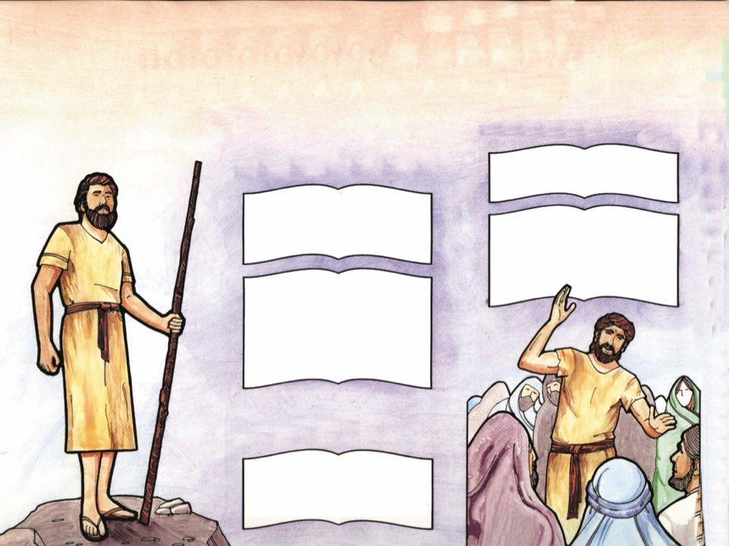
John the Baptist
(The Forerunner of Christ)
John’s Message
Prophecy Concerning John
“And saying, Repent ye: for the kingdom of heaven is at
hand.”
Matthew 3:2
“The voice of him that crieth in the wilderness, Prepare ye the way of the LORD, make straight in the desert a highway for our
“I indeed baptize you with water unto repentance: but he that cometh after me is mightier than I, whose shoes I am not worthy to bear: he shall baptize you with the Holy Ghost, and with fire” Matthew 3:11
God.”
Isaiah 40:3
“Behold, I will send my messenger, and he shall prepare the way before me: and the Lord, whom ye seek, shall suddenly come to his temple, even the messenger of the covenant, whom ye delight in: behold, he shall come, saith the LORD of hosts.” Malachi 3:1
John Introduces Christ to the World
“The next day John seeth Jesus coming unto him, and saith, Behold the Lamb of God, which taketh away the sin of the world.”
John 1:29
Mark1:8 Luke 3:2-17

Slide 34
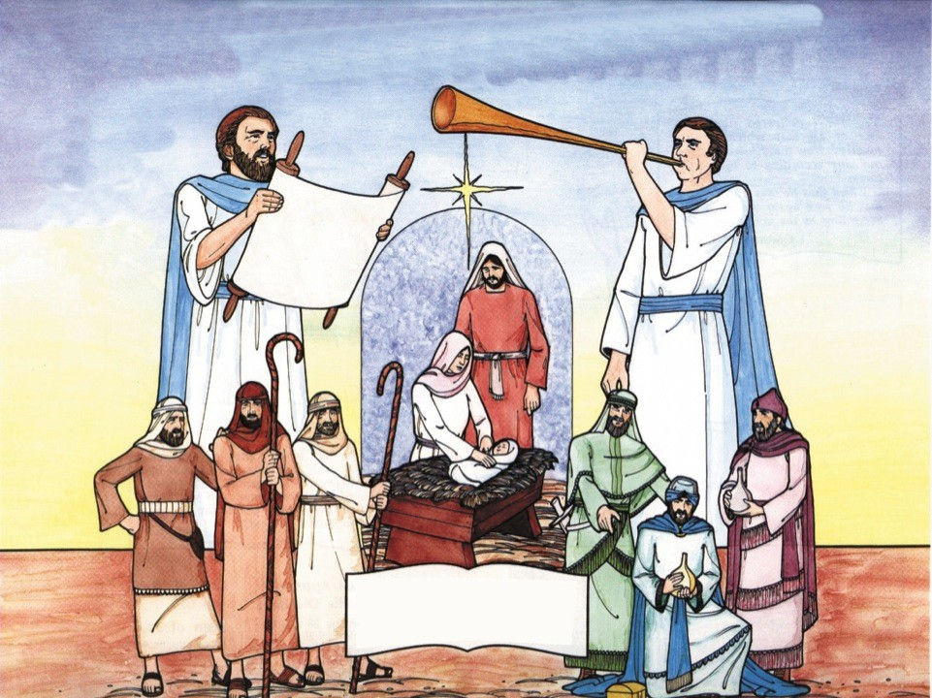
The Birth of Jesus Christ
Prophecy Concerning Jesus
Place of Birth
Micah 5:2
Born of a Virgin
Isaiah 7:4
Isaiah 9:6
“And she shall bring forth a son, and thou shalt call his name JESUS: for he shall save his people from their sins.” Matthew 1:21

Slide 35

Prophecies Concerning Jesus Christ
Genesis 3:15 Isaiah 7:14 | Seed of Woman Virgin Born | Matthew 1:20 Matthew 1:18
Genesis 49:10 | Tribe of Judah | Luke 3:23, 33
Micah 5:2 | Born at Bethlehem | Matthew 2:1
Psalm 72:10 | Presented with Gifts | Matthew 2:1, 11
Jeremiah 31:15 | Herod Kills Children | Matthew 2:16
Isaiah 7:14 | Shall Be Immanuel | Matthew 1:23
Isaiah 40:3 | Preceded by a Messenger | Matthew 3:1-2
Isaiah 35:5-6 | Ministry of Miracles | Matthew 9:35
Zechariah 9:9 | Enter Jerusalem on a Donkey | Luke 19:35-37
Psalm 16:10 | Resurrection | Acts 2:31
Psalm 68:18 | Ascension | Acts 1:9
Psalm 41:9 | Betrayed by a Friend | John 13:21
Zechariah 11:12 | Sold for 30 Pieces of Silver | Matthew 26:15
Zechariah 11:13 | Money Thrown Down in God’s House | Matthew 27:5
Zechariah 13:7 | Forsaken by His Disciples | Matthew 26:56
Psalm 35:11 | Accused by False Witness | Matthew 26:59-60
Isaiah 53:7 | Dumb before Accusers | Matthew 27:12
Isaiah 53:5 | Wounded and Bruised | Matthew 27:26
Isaiah 50:6 | Smitten and Spit Upon | Matthew 27:30
Psalm 22:7-8 | Mocked | Matthew 27:31
Psalm 22:16 | Hands and Feet Pierced | John 20:25
Isaiah 53:12 | Crucified with Thieves | Matthew 27:38
Psalm 22:18 | Garments Parted and Lots Cast | John 19:23-24
Psalm 22:1 | His Forsaken Cry | Matthew 27:46
Psalm 34:20 | Bones Not Broken | John 19:33-36
Zechariah 12:10 | Side Pierced | John 19:34
Amos 8:9 | Darkness Over the Land | Matthew 27:45
Isaiah 53:9 | Buried in Rich Man’s Tomb | Matthew 27:57-60
Old Testament Prophecy
New Testament Fulfillment

Slide 36
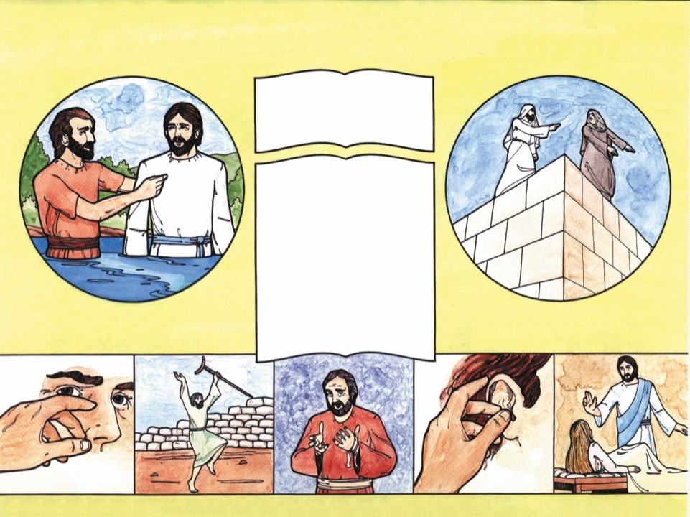
The Miracles of Jesus Christ
“Then the eyes of the blind shall be opened, and the ears of the deaf shall be unstopped.
Then shall the lame man leap as an hart, and the tongue of the dumb sing...” Isaiah 35:5-6
“Now when John had heard in the prison the works of Christ, he sent two of his disciples,
And said unto him, Art thou he that should come, or do we look for another?
Jesus answered and said unto them, Go and show John again those
things which ye do hear and see:
The blind receive their sight, and
the lame walk, the lepers are cleansed, and the deaf hear, the dead are raised up, and the poor have the gospel preached to them.
And blessed is he, whosoever shall not be offended in me.”
Matthew 11:2-6
The Baptism
Matthew 3:13-17
The Temptation
Matthew 4:1-10
Blinded Eyes Opened
Matthew 9:27-30
Lame Walk
John 5:5
Lepers Cleansed
Matthew 8:2-4
Deaf Ears Hear
Mark 7:35-37
Dead Raised
John 11:41-44

Slide 37
Exploring God’s Word
Home Bible Study
Lesson
Seven

Slide 38
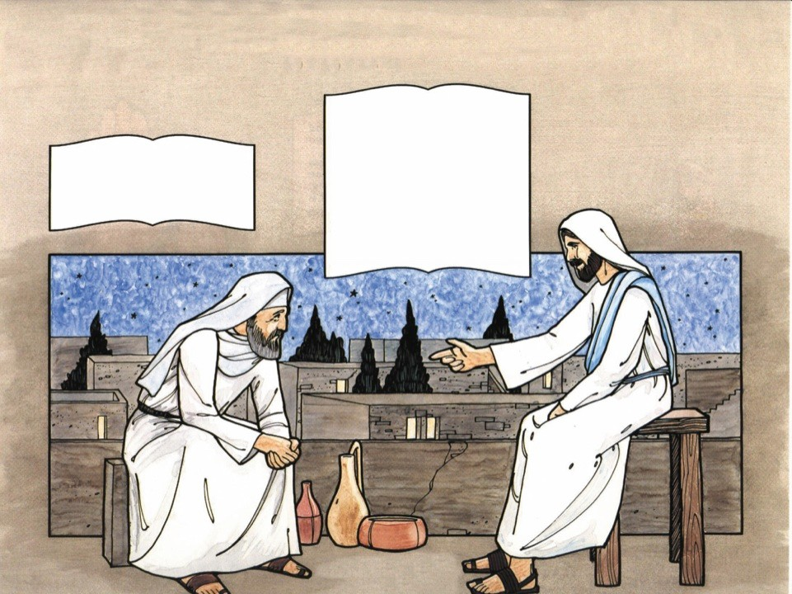
Jesus Teaches the New Birth
“In the last day, that great day of the feast, Jesus stood and cried, saying, If any man thirst, let him come unto me, and drink.
“Jesus answered, Verily, verily, I say unto thee, Except a man be born of water and of the Spirit, he cannot enter into the
He that believeth on me, as the scripture hath said, out of his belly shall flow rivers of living water.
(But this spake he of the Spirit, which they that believe on him should receive: for the Holy Ghost was not yet given; because that Jesus was not yet glorified.)”
John 7:37-39
kingdom of God.” John 3:5
Jesus and Nicodemus
John 3:1-7

Slide 39
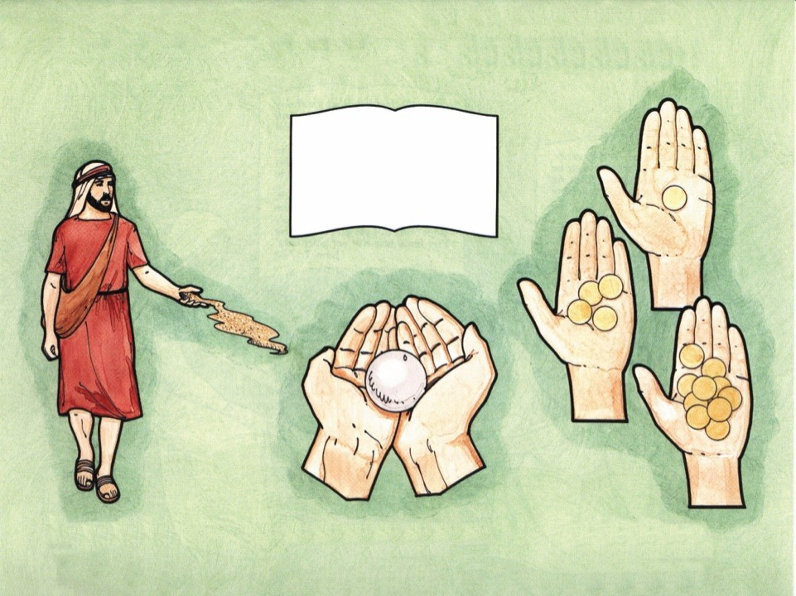
Jesus Teaches the Parables
“And the disciples came, and said unto him, Why speakest thou unto them in parables?
He answered and said unto
them, Because it is given unto you to know the mysteries of the kingdom of heaven, but to them it is not given.” Matthew 13:10-11
The Sower
Matthew 13:1-23
What Kind of Soil Are You?
The Talents
Matthew 25:14-25
What Will You Do With Your Life?
The Pearl of Great Price
Matthew 13:45
What Price Will You Pay?

Slide 40
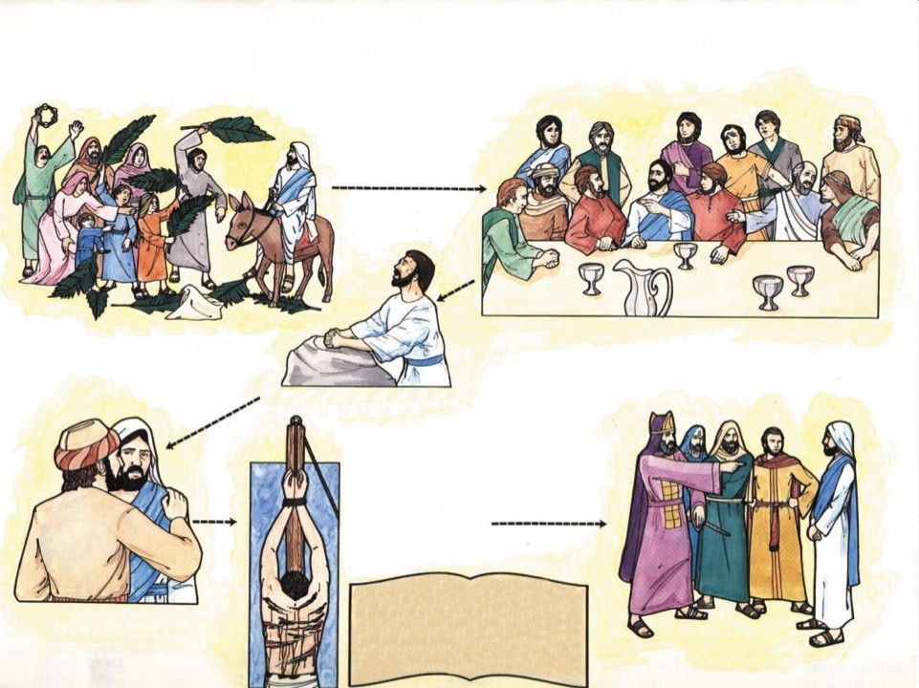
The Road to Calvary
Triumphal Entry
Matthew 21:1-17
Zechariah 9:9
The Last Supper
Matthew 26:18-28
Jesus Prays in Gethsemane
Matthew 26:36-44
Beaten
Isaiah 50:6
Isaiah 52:14
John 19:1
Provision of Healing
Psalm 103:3
Isaiah 53:5
I Corinthians 12:9
James 5:14-16
I Peter 2:24
“But he was wounded for our transgressions, he was bruised for our iniquities: the chastisement of our peace was upon him; and with his stripes we are healed.”
Isaiah 53:5
Betrayed
Matthew 26:46-50
The Trial
Matthew 26:62-68

Slide 41
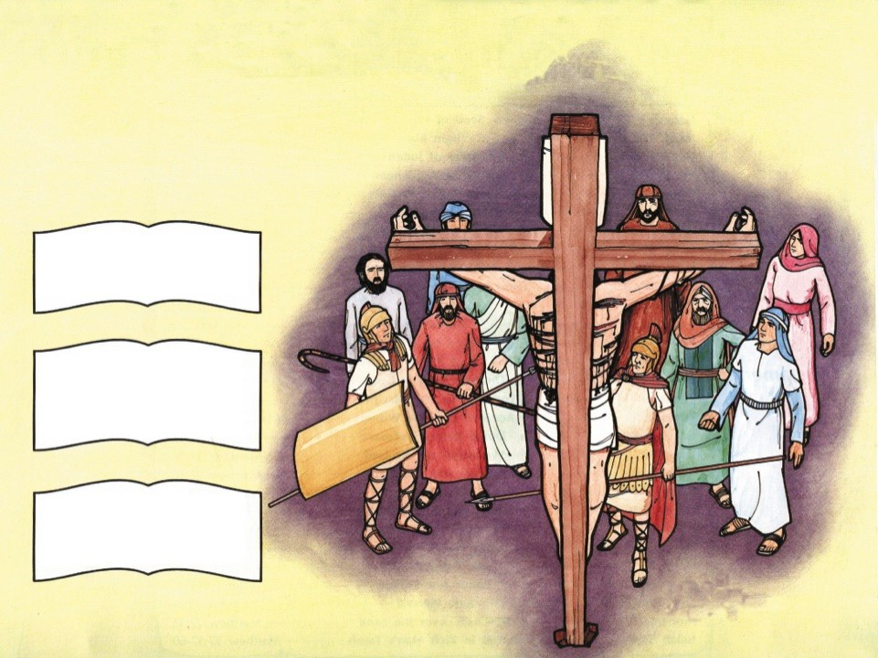
Christ Died for Us
“But God commendeth his love toward us, in that, while we were yet sinners, Christ died for
us.“
Romans 5:8
“For if, when we were enemies, we were reconciled to God by the death of his Son, much more, being reconciled, we shall be saved by his life. “ Romans 5:10
“For he hath made him to be sin for us, who knew no sin; that we might be made the righteousness of God in him.”
II Corinthians 5:21
Matthew 27

Slide 42
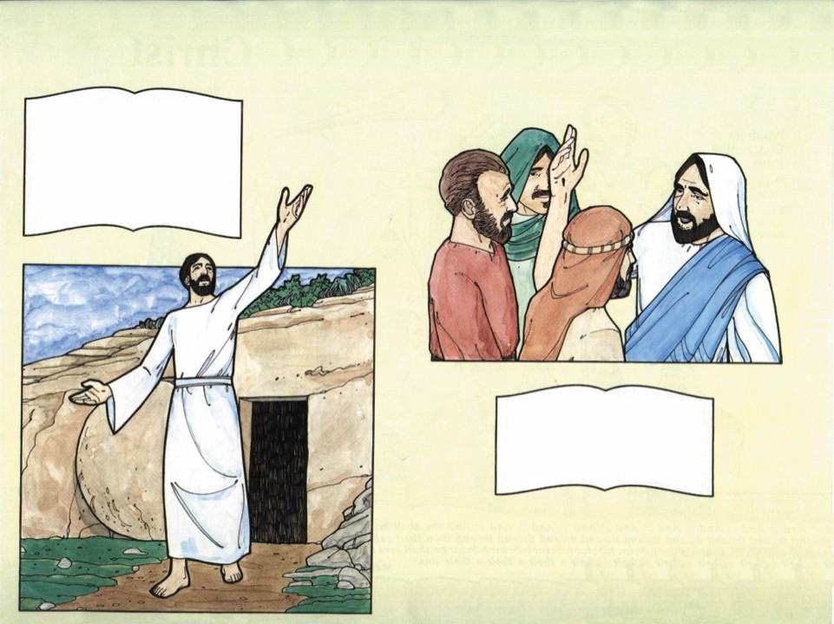
Christ Lives
“For I delivered unto you first of all that which I also received, how that Christ died for our sins according to the scriptures;
And that he was buried, and
that he rose again the third day according to the scriptures:”
I Corinthians 15:3-4
“To whom also he showed himself alive after his passion by many infallible proofs, being seen of them forty days, and speaking of the things pertaining to the kingdom of God:”
Acts 1:3
Jesus Appears To His Disciples
Matthew 28:16-20
Mark 16:9-20
Luke 24:13-53
John 20:19-31
I Corinthians 15:4-7
Seen 40 Days
Acts 1:3
Seen of 500
I Corinthians 15:4-7

Slide 43
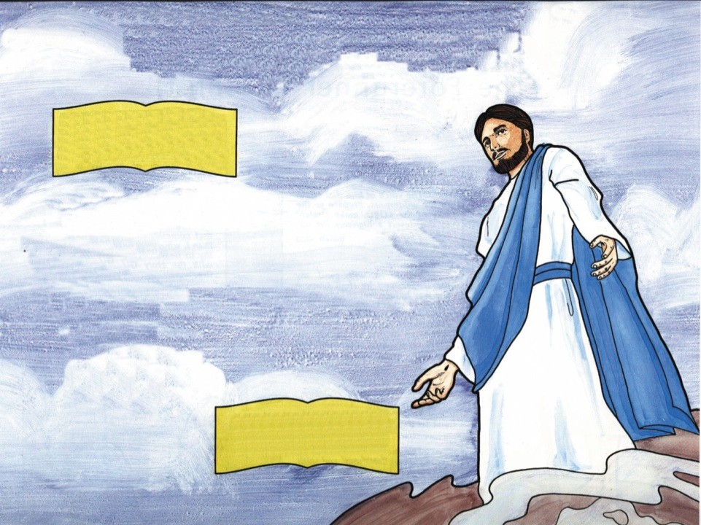
The Great Commission
“And that repentance and remission of sins should be preached in his name among all nations, beginning at Jerusalem.”
Luke 24:47
Great Commission
Matthew 28:19-20
Mark 16:15-18
Luke 24:45-49
Acts 1:4-8
Elements of the Great Commission
Belief
Repentance
Water Baptism
The Holy Ghost with
Supernatural Signs
Teaching
6. Healing
“And when he had spoken these things, while they beheld, he was taken up; and a cloud received him out of their sight.” Acts 1:9

Slide 44
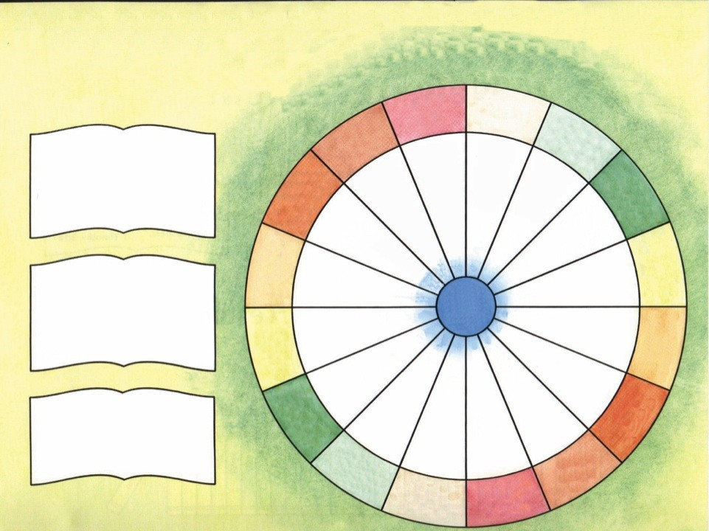
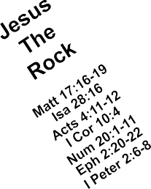
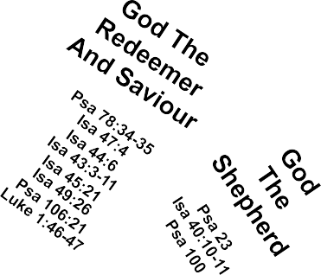
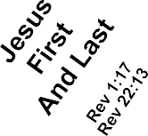


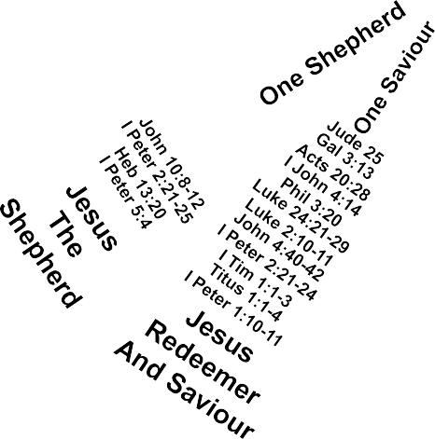

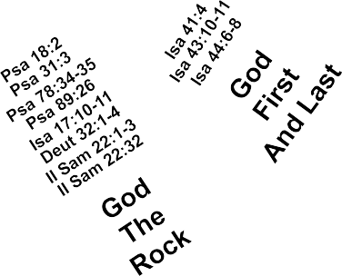
The Mighty God In Christ
Jesus
God
Is
The
Coming
Creator
“Beware lest any man spoil you through philosophy and vain deceit, after the tradition of men, after the rudiments of the world, and not after Christ.
For in him dwelleth all the fulness of the Godhead bodily.”
Colossians 2:8-9
I Thess 3:11-13
Gen 1:1
Matt 25:31-46
Gen 2:7
Titus 2:11-13
Job 33:4
Psalm 33:6
Psalm 104:30
Isa 40:28
Isa 44:24
Isa 45:11-18
Mal 2:10
One Is Coming
One Creator
Jesus
The
God
The I Am
And
King
I Am He
Psa 24
“And without controversy great is the mystery of godliness: God was manifest in the flesh, justified in the Spirit, seen of angels, preached unto the Gentiles, believed on in the world, received up into glory.”
I Timothy 3:16
John 18:5-8
Psa 44:4
Rev 1:17-18
Psa 74:12
John 8:24-28
Isa 43:10-15
Isa 44:6-8
Jer 10:10
ONE GOD
Zech 14:9
One I Am—One I Am He
One King
Matt 2:1-6
One King
One I Am—One I Am He
Luke 19:32-38
Luke 23:3
John 18:37
John 19:21
Isa 43:10-11; 25
I Tim 6:13-16
Exodus 3:13-14
Jesus
Rev 15:1-4
God
The
Rev 19:11-16
The I Am
King
And
The I Am He
One Creator
One Is Coming
“To wit, that God was in Christ, reconciling the world unto himself, not imputing their trespasses unto them; and hath committed unto us the word of reconciliation.” II Corinthians 5:19
John 1:10
I Cor 8:6
Eph 3:9
Col 1:12-17
Heb 1:8-12
Rev 4:8-11
Zech 14:4-5
Rev 10:6
I Thess 4:13-18
Rev 14:6-7
Rev 19:11 & 16
Rev 21:5-7
Psalm 50:1-6
Rev 22:3
Jesus
God
The
Is
Creator
Coming

Slide 45
Exploring God’s Word
Home Bible Study
Lesson
Eight

Slide 46
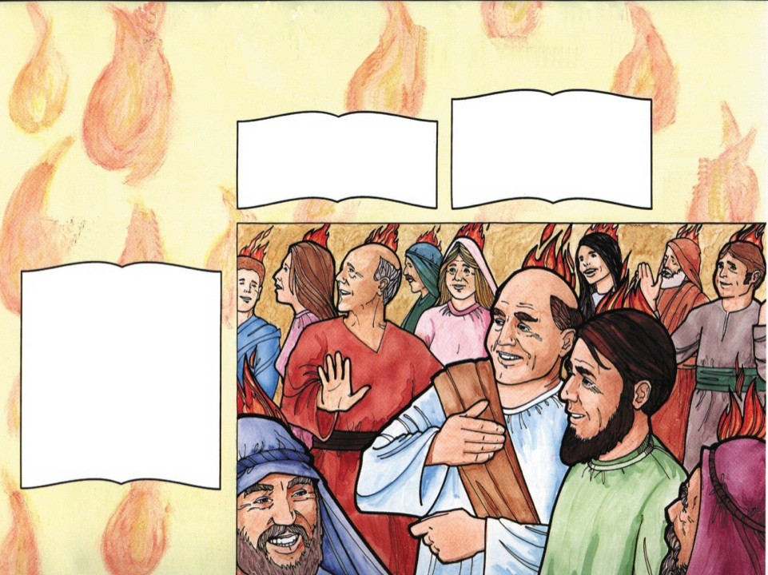
The Birth of the Church
The Promise of the Holy Ghost
“But ye shall receive power, after that the Holy Ghost is come upon
“And, behold, I send the promise of my Father upon you: but tarry ye in the city of Jerusalem, until ye be endued with
you: and ye shall be witnesses unto me both in Jerusalem, and in all Judaea, and in Samaria, and unto the uttermost part of the earth.”
Acts 1:8
Isaiah 28:11-12
Jeremiah 31:31
Joel 2:28-29
John 7:37-39
power from on high.”
Luke 24:49
And They Were All Filled with the Holy Ghost
“And when the day of Pentecost was fully come, they were all with one accord in one place.
And suddenly there came a sound from heaven as of a rushing mighty wind, and it filled all the house where they were sitting.
And there appeared unto them
cloven tongues like as of fire, and it sat upon each of them.
And they were all filled with the Holy Ghost, and began to speak with other tongues, as the Spirit gave them utterance.” Acts 2:1-4
Acts 1:5 & 8

Slide 47
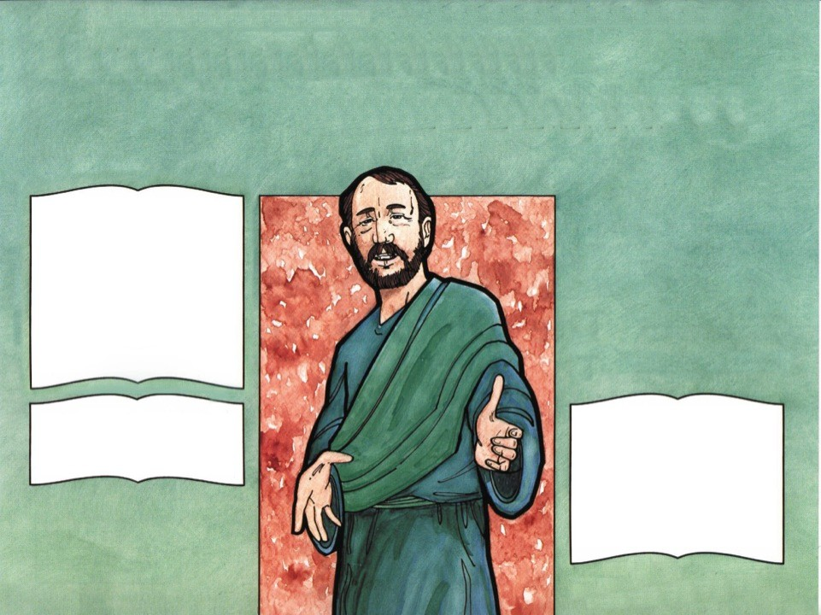
Peter Preaches Christ
God’s Plan for Us
“Ye men of Judaea, and all ye that dwell at Jerusalem, be this known unto you, and hearken to my words:
For these are not drunken, as ye suppose, seeing it is but the third hour of the day.
But this is that which was
spoken by the prophet Joel;
And it shall come to pass in the last days, saith God, I will pour out of my Spirit upon all
What Shall We Do?
flesh:”
Acts 2:14-17
“Therefore let all the house of Israel know assuredly, that God hath made that same Jesus, whom ye have crucified, both
“Then Peter said unto them, Repent, and be baptized every one of you in the name of Jesus Christ for the remission of sins, and ye shall receive the gift of the Holy Ghost.
For the promise is unto you, and to your children, and to all that are afar off, even as many as the Lord our God shall call.”
Acts 2:38-39
Lord and Christ.”
Acts 2:36
3,000 Converts!
Acts 2:41

Slide 48
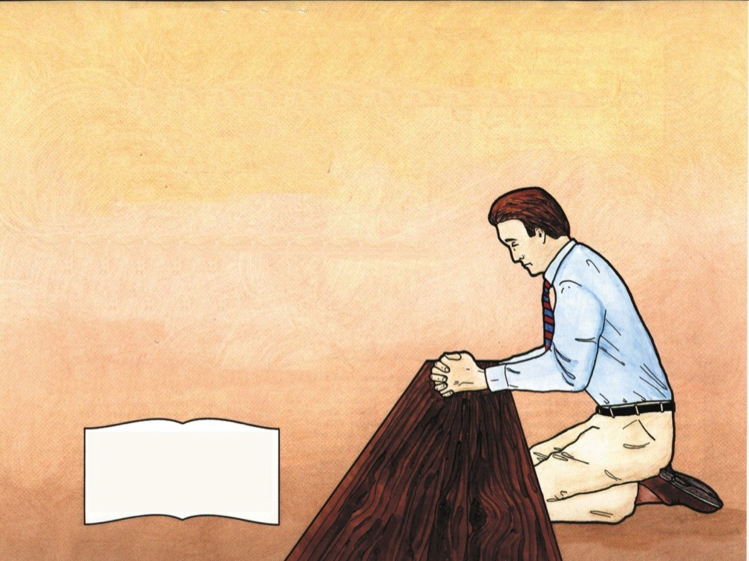
Repentance
The First Step in God’s Plan for Salvation
To experience sorrow and conviction over past sins, and a turning away from future sin.
John the Baptist Preached Repentance
Matthew 3:2
Mark 1:4
Jesus Preached Repentance
Luke 13:3
Luke 24:47
Peter Preached Repentance
Acts 2:38
“The Lord is not slack concerning his promise, as some men count slackness; but is longsuffering to us-ward, not willing that any should perish, but that all should come to
repentance.”
II Peter 3:9

Slide 49
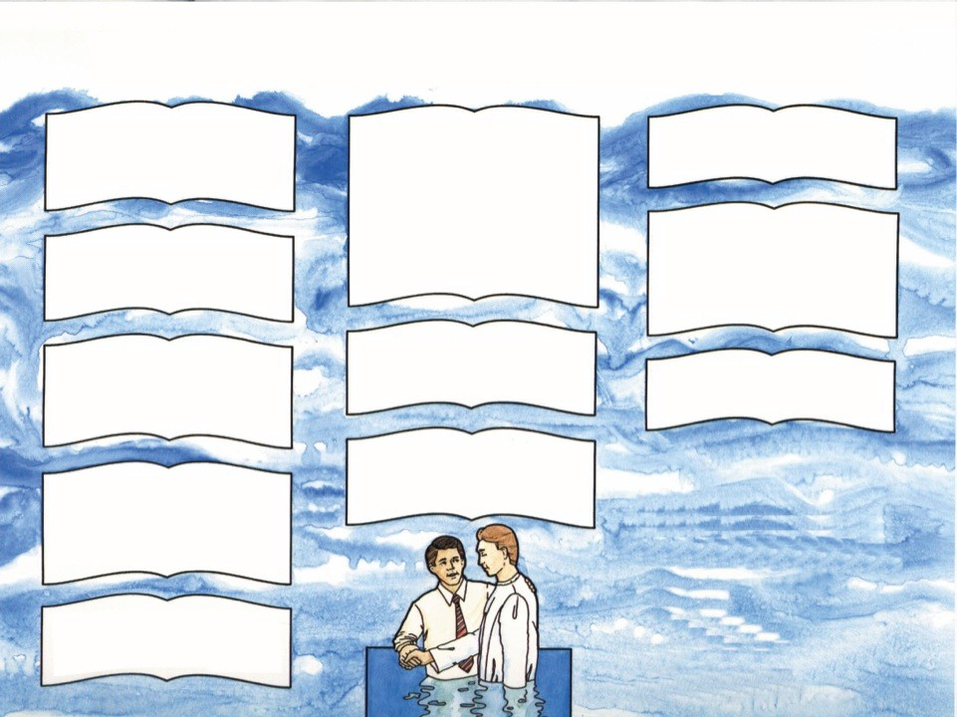
Buried with Him in Baptism
“Go ye therefore, and teach all nations, baptizing them in the name of the Father, and of the Son, and of the Holy Ghost:”
Matthew 28:19
“And he commanded the chariot to stand still: and they went down both into the water, both Philip and the eunuch; and he baptized him.
And when they were come up out of the water, the Spirit of the Lord caught away Philip, that the eunuch saw him no more: and he went on his way rejoicing.”
Acts 8:38-39
“When they heard this, they were baptized in the name of the Lord Jesus.” Acts 19:5
“Therefore we are buried with him by baptism into death: that like as Christ was raised up from the dead by the glory of the Father, even so we also should walk in newness of life.”
Romans 6:4
“He that believeth and is baptized shall be saved; but he that believeth not shall be damned.” Mark 16:16
“And he commanded them to be baptized in the name of the Lord. Then prayed they him to tarry certain days.” Acts 10:48
“Jesus answered, Verily, verily, I say unto thee, Except a man be born of water and of the Spirit, he cannot enter into the kingdom of God.” John 3:5
“For as many of you as have been baptized into Christ have put on Christ.” Galatians 3:27
“And now why tarriest thou? arise, and be baptized, and wash away thy sins, calling on the name of the Lord.” Acts 22:16
How?
Immersion in the name of Jesus Christ
“Then Peter said unto them, Repent, and be baptized every one of you in the name of Jesus Christ for the remission of sins, and ye shall receive the gift of the Holy Ghost.” Acts 2:38
Who?
Every New Testament believer was baptized
“(For as yet he was fallen upon none of them: only they were baptized in the name of the Lord Jesus.)” Acts 8:16

Slide 50
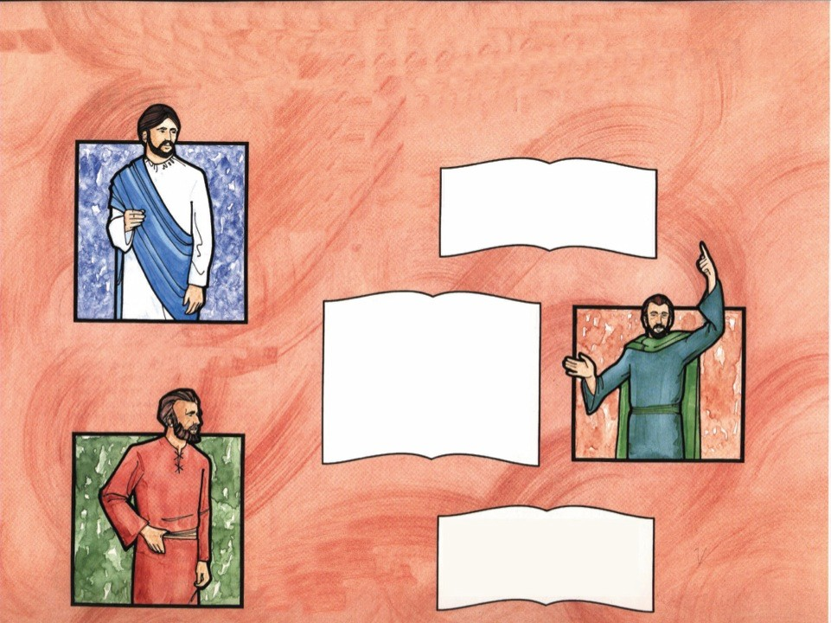
Have You Received the Holy Ghost?
“Jesus answered, Verily, verily, I say unto thee, Except a
Jesus said…
man be born of water and of the Spirit, he cannot enter into the
kingdom of God.” John 3:5
“Then Peter said unto them, Repent, and be baptized every one of you in the name of Jesus Christ for the remission of sins, and ye shall receive the gift of the Holy Ghost.
For the promise is unto you, and to your children, and to all that are afar off, even as many as the Lord our God shall call.”
Acts 2:38-39
Peter said…
“But ye are not in the flesh, but in the Spirit, if so be that the Spirit of God dwell in you. Now if any man have not the Spirit of Christ, he is none of his.”
Romans 8:9
Paul said…

Slide 51
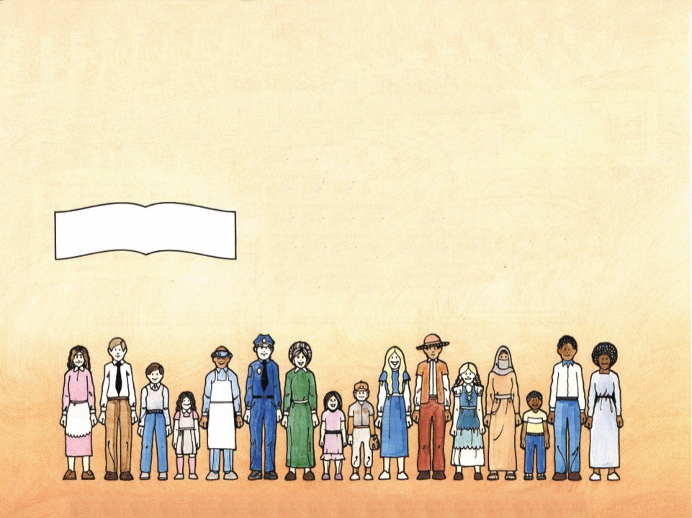
The Evidence of the Holy Ghost
“And they were all filled with the Holy Ghost, and began to speak with other tongues, as the Spirit gave them utterance.” Acts 2:4
Apostles – Acts 2
The Mother of Jesus – Acts 2
Samaritans – Acts 8
Cornelius, His Family and Friends – Acts 10
Disciples of John the Baptist – Acts 19
Paul – I Corinthians 14:18 & 39
“For they heard them speak with tongues, and magnify
God.”
Acts 10:46
The Holy Ghost Is for Everyone
Acts 11:14-17

Slide 52
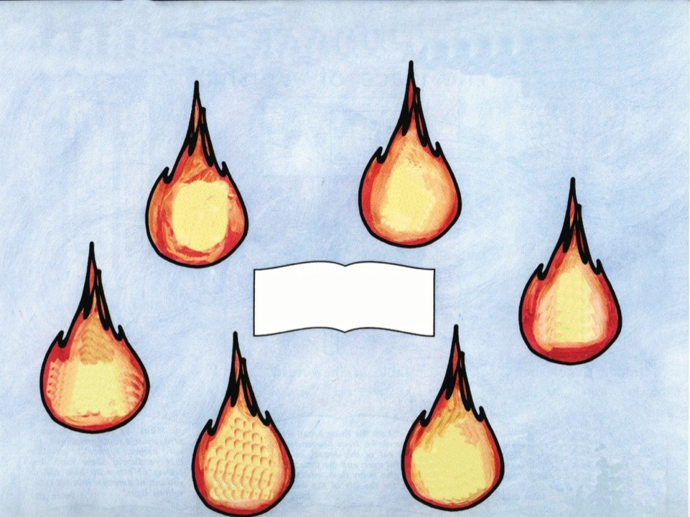
The Power of the Holy Ghost
The Spirit Shows Things To Come
John 16:13
The Spirit Gives Power
Acts 1:8
“But ye are not in the flesh, but in the Spirit, if so be that the Spirit of God dwell in you.”
Romans 8:9
The Spirit Teaches
John 14:26
The Spirit Gives
Righteousness, Peace, & Joy
Romans 14:17
The Spirit Imparts The Love Of God
Romans 5:5
The Spirit Gives
Immortality
Romans 8:11 I Corinthians 15:51-53

Slide 53
Exploring God’s Word
Home Bible Study
Lesson
Nine

Slide 54

The Gifts of the Spirit
I Corinthians 12:1-10
“Now we have received, not the spirit of the world, but the spirit which is of God; that we might know the things that are freely given to us of God.”
I Corinthians 2:12
Word
Word
Of
Of
Wisdom
Knowledge
Gift
Gift
Working
Of
Of
Of
Faith
Healing
Miracles
Discerning
Divers Kinds
Interpretation
Prophecy
Of
Of
Of
Spirits
Tongues
Tongues

Slide 55
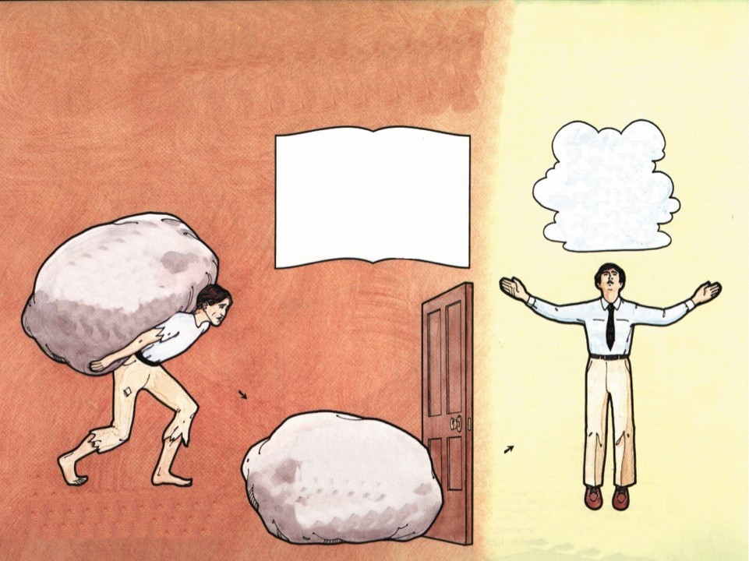









From the Old Man to the New Man
“That ye put off concerning the former conversation the old man, which is corrupt according to the deceitful lusts;
And be renewed in the spirit of your mind;
And that ye put on the new man, which after God is created in righteousness and true holiness.”
Ephesians 4:22-24
Fruit of the Spirit
Galatians 5:19-21
Works of the Flesh
Adultery Fornication Uncleanness Lasciviousness Idolatry Witchcraft Hatred Variance Emulations Wrath Strife Seditions Heresies Envyings Murder Drunkenness Revellings
Galatians 5:22
Love Joy Peace Gentleness Goodness Longsuffering Faith Meekness Temperance

Slide 56
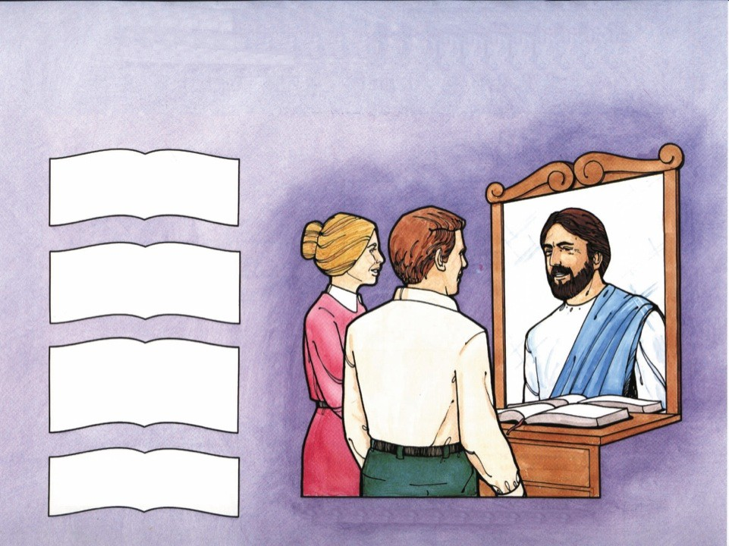
The Beauty of Holiness
“Give unto the LORD the glory due unto his name; worship the LORD in the beauty of holiness.” Psalm 29:2
“Let your light so shine before men, that they may see your good works, and glorify your Father which is in heaven.” Matthew 5:16
“Having therefore these promises, dearly beloved, let us cleanse ourselves from all filthiness of the flesh and spirit, perfecting holiness in the fear of
God.”
II Corinthians 7:1
“Follow peace with all men, and holiness, without which no man shall see the Lord:” Hebrews 12:14
Our Life Should Be a Reflection of Jesus

Slide 57
Exploring God’s Word
Home Bible Study
Lesson
Ten

Slide 58
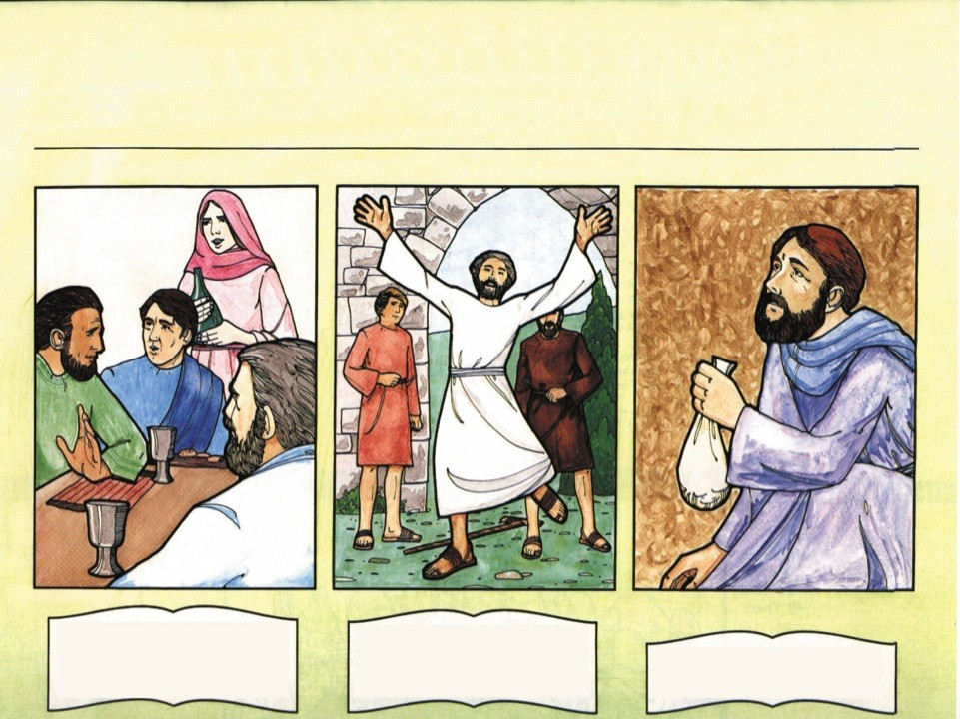
The New Testament Church
The Church Grows
3,000 People (Acts 2:41) ● 5,000 People (Acts 4:4) ● Multitudes (Acts 5:14) ● Great Company of the priests (Acts 6:7)
Fellowship First Miracle in the Church Barnabas Shows the Way
“And they continued stedfastly in the apostles' doctrine and fellowship, and in breaking of
“And he leaping up stood, and walked, and entered with them into the temple, walking, and leaping, and praising God.”
Acts 3:8
“Having land, sold it, and brought the money, and laid it at
bread, and in prayers.”
Acts 2:42
the apostles' feet.”
Acts 4:37

Slide 59

Persecution of the Church
“And cast him out of the city, and stoned him: and the witnesses laid down their clothes at a young man's feet, whose
name was Saul.”
Acts 7:58
Saul consents to Stephen’s death
Acts 8:1
Saul makes havoc of the Church
Acts 8:3
“And he fell to the earth, and heard a voice saying unto him, Saul, Saul, why persecutest thou
me?”
Acts 9:4
Stephen’s Stoning
Acts 7:54-60
Saul’s Conversion
Acts 9:1-31

Slide 60

The Gospel to the Gentiles / Peter
“Peter went up upon the housetop to pray about the sixth hour:
And he became very hungry,
and would have eaten: but while they made ready, he fell into a
“Then Peter opened his mouth, and said, Of a truth I perceive that God is no respecter of persons:
But in every nation he that feareth him, and worketh
righteousness, is accepted with
“He saw in a vision evidently about the ninth hour of the day an angel of God coming in to him, and saying unto him, Cornelius.”
Acts 10:3
trance,”
Acts 10:9-10
him.”
Acts 10:34-35
Cornelius and the Angel
Peter on the Rooftop
Gentiles Receive the Holy Ghost

Slide 61

The Gospel to the Gentiles / Paul
“Then Paul and Barnabas waxed bold, and said, It was necessary that the word of God should first have been spoken to you: but seeing ye put it from you, and judge yourselves unworthy of everlasting life, lo, we turn to the
Gentiles.”
Acts 13:46
“Then Paul stood in the midst of Mars' hill, and said, Ye men of Athens, I perceive that in all things ye are too superstitious.”
Acts 17:22
“I have fought a good fight, I have finished my course, I have
kept the faith:”
II Timothy 4:7
Paul on Mars’ Hill
Paul in Prison

Slide 62
Exploring God’s Word
Home Bible Study
Lesson
Eleven

Slide 63

The Destruction of Jerusalem
“For the days shall come upon thee, that thine enemies shall cast a trench about thee, and compass thee round, and keep thee in on every side,
And shall lay thee even with the ground, and thy children within thee; and they shall not leave in thee one stone upon another; because thou knewest not the time of thy visitation.” Acts 19:43-44
Jerusalem destroyed by the armies of Titus (A.D. 70)

Slide 64

The Jewish Return to Palestine
“And he shall set up an ensign for the nations, and shall assemble the outcasts of Israel, and gather together the dispersed of Judah from the four corners of
the earth.”
Isaiah 11:12
“Fear not: for I am with thee: I will bring thy seed from the east, and gather thee from the west;
I will say to the north, Give up; and to the south, Keep not back: bring my sons from far, and my daughters from the ends of the earth;” Isaiah 43:5-6
“I will gather you from all the nations, and from all the places whither I have driven you, saith the LORD; and I will bring you again into the place whence I caused you to be carried away
Israel Becomes a Nation
May 15, 1948
captive.”
Jeremiah 29:14

Slide 65

The Times of the Gentiles
Nebuchadnezzar's
Dream
Head of Gold (Babylon)
Breast and Arms of Silver (Medo-Persia)
“Thou, O king, sawest, and behold a great image. This great image, whose brightness was excellent, stood before thee; and the form thereof was terrible.
This image's head was of fine
gold, his breast and his arms of silver, his belly and his thighs of brass,
His legs of iron, his feet part of
iron and part of clay.”
Daniel 2:31-33
Belly and Thighs of Brass (Greece)
Legs of Iron (Roman Empire)
Feet of Iron and Clay
(Revived Roman Empire)
“The king answered unto Daniel, and said, Of a truth it is, that your God is a God of gods, and a Lord of kings, and a revealer of secrets, seeing thou couldest
The Stone
(Jesus Christ)
reveal this secret.”
Daniel 2:47

Slide 66

Signs of the End Time
“And as he sat upon the mount of Olives, the disciples came unto him privately, saying, Tell us, when shall these things be? and what shall be the sign of thy coming, and of the end of the
Eating and Drinking, Marrying and Giving in Marriage
Matthew 24:38
Earthquakes in Divers Places
Matthew 24:7
Men’s Hearts Failing Them for Fear
Luke 21:26
world?”
Matthew 24:3
Closed for
Summer
Vacation
Having a Form of Godliness, but Denying The Power Thereof
II Timothy 3:5
Wars and Rumors of Wars
Matthew 24:6
Disobedient to Parents
II Timothy 3:2

Slide 67

Jesus Comes for His Church
“For the Lord himself shall descend from heaven with a shout, with the voice of the archangel, and with the trump of God: and the dead in Christ shall rise first:
Then we which are alive and
remain shall be caught up together with them in the clouds, to meet the Lord in the air: and so shall we ever be with the Lord.”
I Thessalonians 4:16-17
Matthew 24:44
I Corinthians 15:51-54
I Thessalonians 4:13-17

Slide 68
Exploring God’s Word
Home Bible Study
Lesson
Twelve

Slide 69

The Tribulation
Seal
Seal
Seal
Seal
Seal
Seal
Seal
Seven Seals
Revelation 6 & 8:1
Seven Angels with Trumpets
Revelation 6 & 9
Seven Angels with Vials
Revelation 16
Sores
Hail
War
Famine
Death
Earthquakes
445 B.C.
Daniel’s Seventieth Week
The Millennium
Babylonian Captivity
Daniel’s Sixty Nine Weeks
The Church Age
(Daniel did not see
the church age)
The Rapture
7 Weeks (49 Years)
To the rebuilding of Jerusalem
62 Weeks (434 Years)
Till the Crucifixion of the Messiah
7 Years
The Great Tribulation

Slide 70

The Reign of the Antichrist
False Prophet
(Religious Leader)
Military Leader Economic Leader
Political Leader
“… and that man of sin be revealed, the son of perdition;
Who opposeth and exalteth himself above all that is called God, or that is worshipped; so that
he as God sitteth in the temple of God, showing himself that he is
Antichrist
One World Government Will Be Controlled By the Antichrist
Revelation 13 describes the Antichrist as a “beast” rising out of the sea.
God.”
II Thessalonians 2:3-4

Slide 71

The Battle of Armageddon
144,000 Sealed
“For they are the spirits of devils, working miracles, which go forth unto the kings of the earth and of the whole world, to gather them to the battle of that great day of God Almighty.
And he gathered them together into a place called in the Hebrew tongue Armageddon.”
Revelation 16:14 & 16
Revelation 7
Armageddon
“And I saw heaven opened, and behold a white horse; and he that sat upon him was called Faithful and True, and in righteousness he doth judge and
make war.”
Revelation 19:11

Slide 72

The Return of Christ
and the Millennium
Antichrist Army Destroyed
“And the LORD shall be king over all the earth: in that day shall there be one LORD, and his name
“And his feet shall stand in that day upon the mount of Olives, which is before Jerusalem on the east, and the mount of Olives shall cleave in the midst
one.”
Zechariah 14:9
Satan will be bound during the 1,000 years
Revelation 20:2-3
Jesus will reign on the earth 1,000 years
Revelation 20:6
thereof.”
Zechariah 14:4

Slide 73

The Great White Throne Judgment
“And I saw the dead, small and great, stand before God; and the
books were opened: and another book was opened, which is the book of life: and the dead were judged out of those things which were written in the books, according to their
“And whosoever was not found written in the book of life was cast into the lake of fire.”
Revelation 20:15
works.” Revelation 20:12

Slide 74

Time Ends – Then Eternity
“In my Father's house are many mansions: if it were not so, I would have told you. I go to prepare a place for you.
And if I go and prepare a place for you, I will come again, and receive you unto myself; that where I am, there ye may be also.”
John 14:2-3
Heavens and Earth Destroyed
II Peter 3:10
New Jerusalem
Revelation 21
“He which testifieth these things saith, Surely I come quickly. Amen. Even so, come, Lord Jesus.
The grace of our Lord Jesus Christ be with you all. Amen.”
Revelation 22:20-21
New Heaven and New Earth
II Peter 3:10
Revelation 21:1

